Slide 1





STEAM
Data analysis
Prepared by
Prafful singh

Slide 2


CONTENT
1. INTRODUCTION
2. DATA PREPARATION
3. DATA CLEANING
4. DATA VISUALIZATION
5. DATA INSIGHTS
Prafful Singh

Slide 3
DATA preparation
Importing Libraries and Loading the Dataset
Converting Columns to Appropriate Data Types
Data Overview and Missing Values
Missing Values Analysis
Prafful Singh

Slide 4
DATA CLEANING
Handling Missing Values
Handling Missing Values in 'About the Game' Column
Handling Missing Values in 'Supported Languages,' 'Full Audio Languages,' and 'Reviews' Columns
Creating OS Columns and Data Type Conversion
Initial Data Exploration
Cleaning Developers and Publishers Columns
Handling Missing Data in 'Categories' Column
Cleaning Tags and Screenshots Columns
Removing Redundant Columns
Prafful Singh

Slide 5


DATA visualization
Most Downloaded Games
Most Expensive Games
Most Downloaded Games and Their Prices
Prices Distribution
Average Downloads for Free and Paid Games
Most Supported Languages
Average Downloads for Games with Support vs. Games without Support
Average Downloads for Games by Operating System
Top Rated Games by Positive and Negative Ratings
Most Downloaded Games with Their Positive and Negative Ratings
Relationship Between Number of Downloads and Ratings of Games
Relationship Between Price and Ratings
Top Developers
Top Publishers
Distribution of Games by Categories
Top Genres
Most Common Year in Which Games Were Produced
Correlation Analysis of Game Metrics
Standard Deviation of Average and Median Playtime for the Last Two Decades
Prafful Singh

Slide 6
DATA insights
Business impact
Recommendations
Key Findings
Conclusion
Prafful Singh

Slide 7


INTRODUCTION
Welcome to the Steam Data Quest! In this presentation, we’ll embark on a journey through Steam’s game universe, where data holds the key to uncovering the hidden secrets of player behavior, game popularity, and market trends. This Exploratory Data Analysis (EDA) project will be powered by Python and its robust libraries like Pandas, Matplotlib, Seaborn, and more. We’ll start by cleaning the data to ensure accuracy, then dive into visualizations to reveal the most downloaded games, player ratings, and much more. By the end, we’ll have unlocked the power of data to guide future game strategies on Steam’s platform!
Prafful Singh

Slide 8



PRAFFUL SINGH
Prafful is a Data Analyst skilled in Python, SQL, Excel, Power BI, and story telling. He specializes in cleaning datasets, extracting insights, and transforming data into actionable strategies. With expertise in statistical analysis and machine learning, he uncovers hidden patterns, making him a strong force in analytics. His standout ability, Insight Storm, simplifies complex data for impactful presentations.
Prafful Singh

Slide 9

RICK GRIMES
Rick is the Marketing Director for Steam, skilled in promoting games and boosting player engagement. With a keen sense of market trends and player behavior, he creates campaigns that maximize game exposure. His expertise in community building and data-driven strategies ensures long-term success, and his signature move, Hype Surge, turns game releases into must-see events.
Prafful Singh

Slide 10

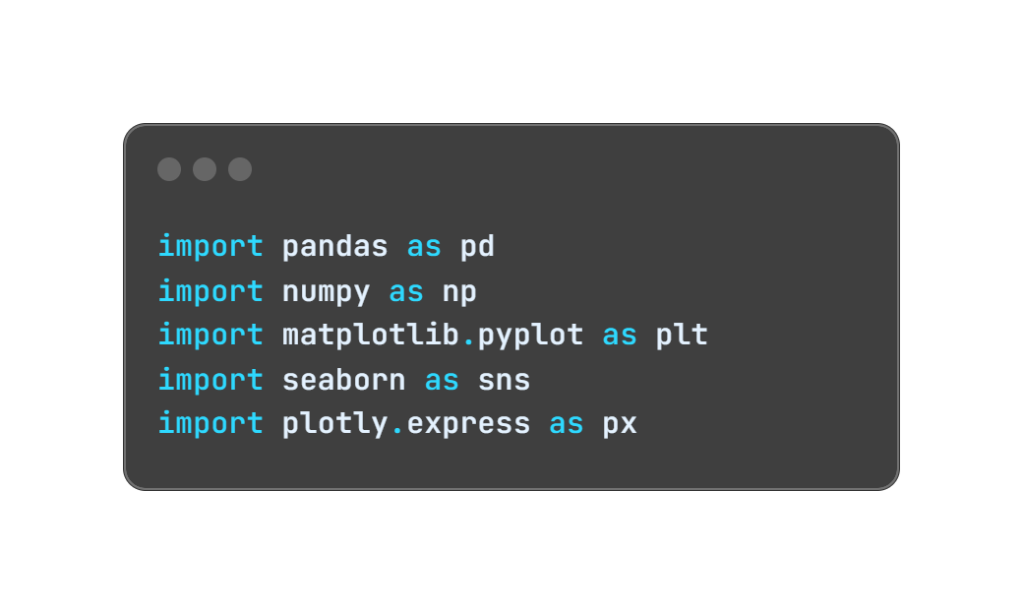
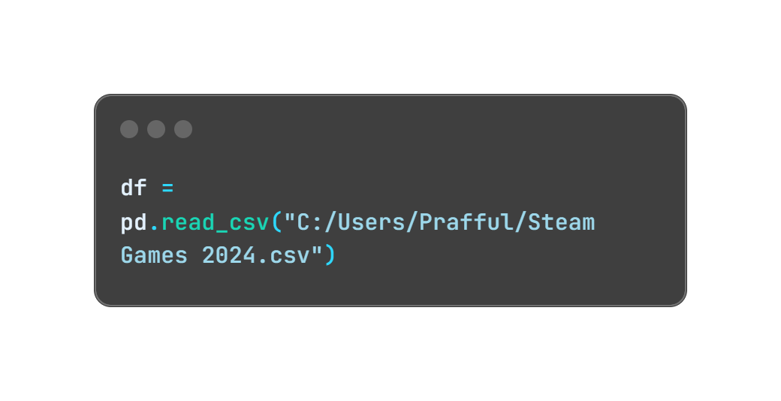
Importing Libraries and Loading the Dataset
Libraries Imported:
pandas: A powerful data manipulation library, used to handle tabular data in DataFrames.
numpy: Essential for numerical operations, such as array manipulation.
matplotlib.pyplot: A popular library for creating static visualizations, such as plots and charts.
seaborn: Built on top of Matplotlib, it provides a high-level interface for drawing attractive statistical graphics.
plotly.express: Useful for creating interactive visualizations and plots.
Dataset:
We have loaded the Steam Games 2024 dataset, which contains a wide range of information about games available on Steam. The dataset is loaded using pandas.read_csv and is stored in a DataFrame (df).
Prafful Singh

Slide 11



Here’s a dataset we’ve collected from Steam games. Can you clean it up and extract some valuable insights for me to improve our marketing strategies?
Absolutely! Let’s start by cleaning the dataset to make sure it’s ready for analysis.
Also can you provide a quick overview of the dataset? Do we have any missing or incomplete data?
I’ll give you a summary of the data, highlighting any gaps or missing values that need to be cleaned up.
Prafful Singh

Slide 12

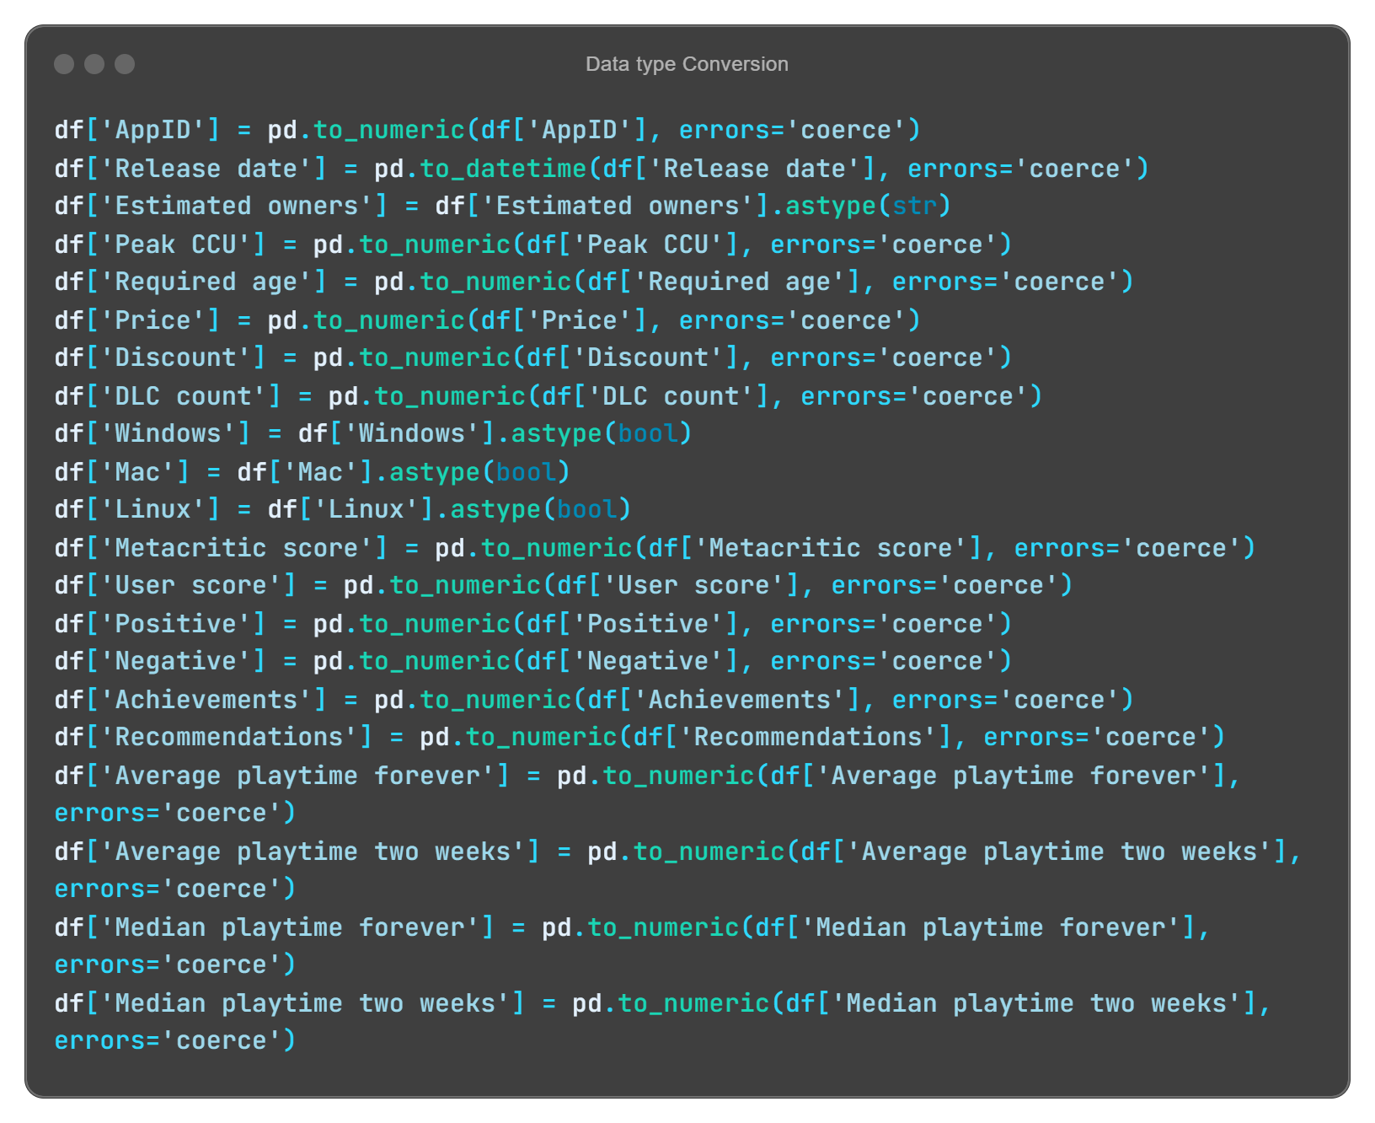
Converting Columns to Appropriate Data Types
In this step, I ensured that each column in the dataset had the correct data type to allow for accurate analysis and manipulation.
Purpose: Data type conversion ensures that columns have the correct format for future operations like statistical analysis, visualization, and modeling. It also helps prevent errors during data processing.
Prafful Singh

Slide 13

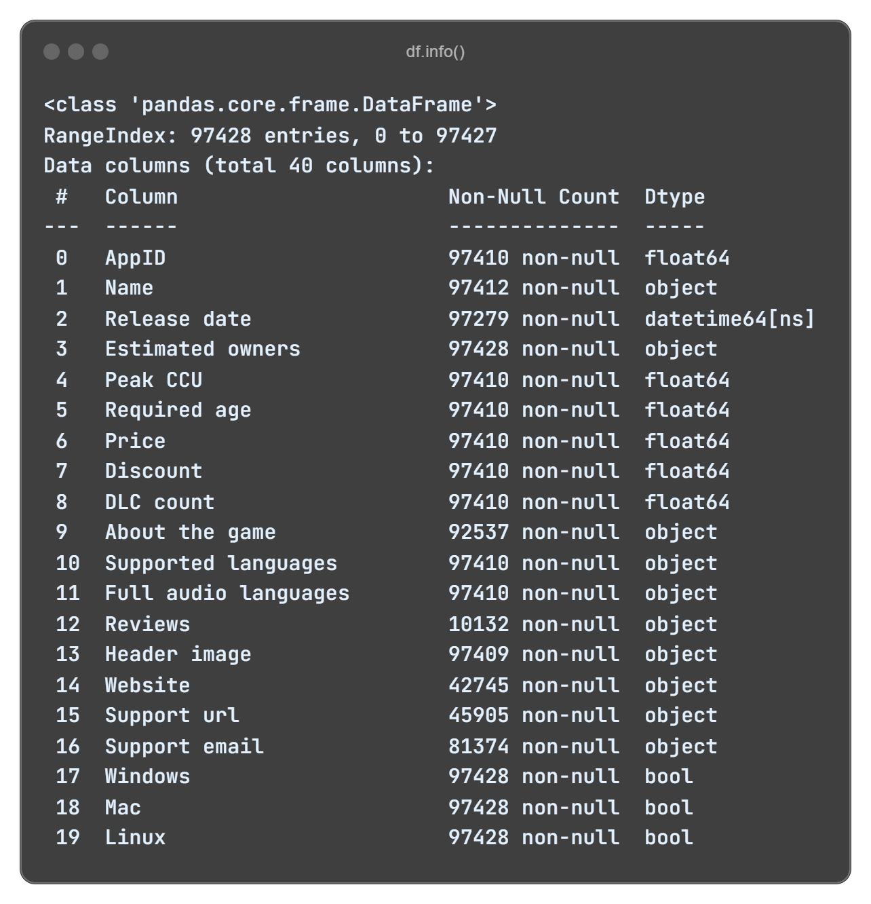
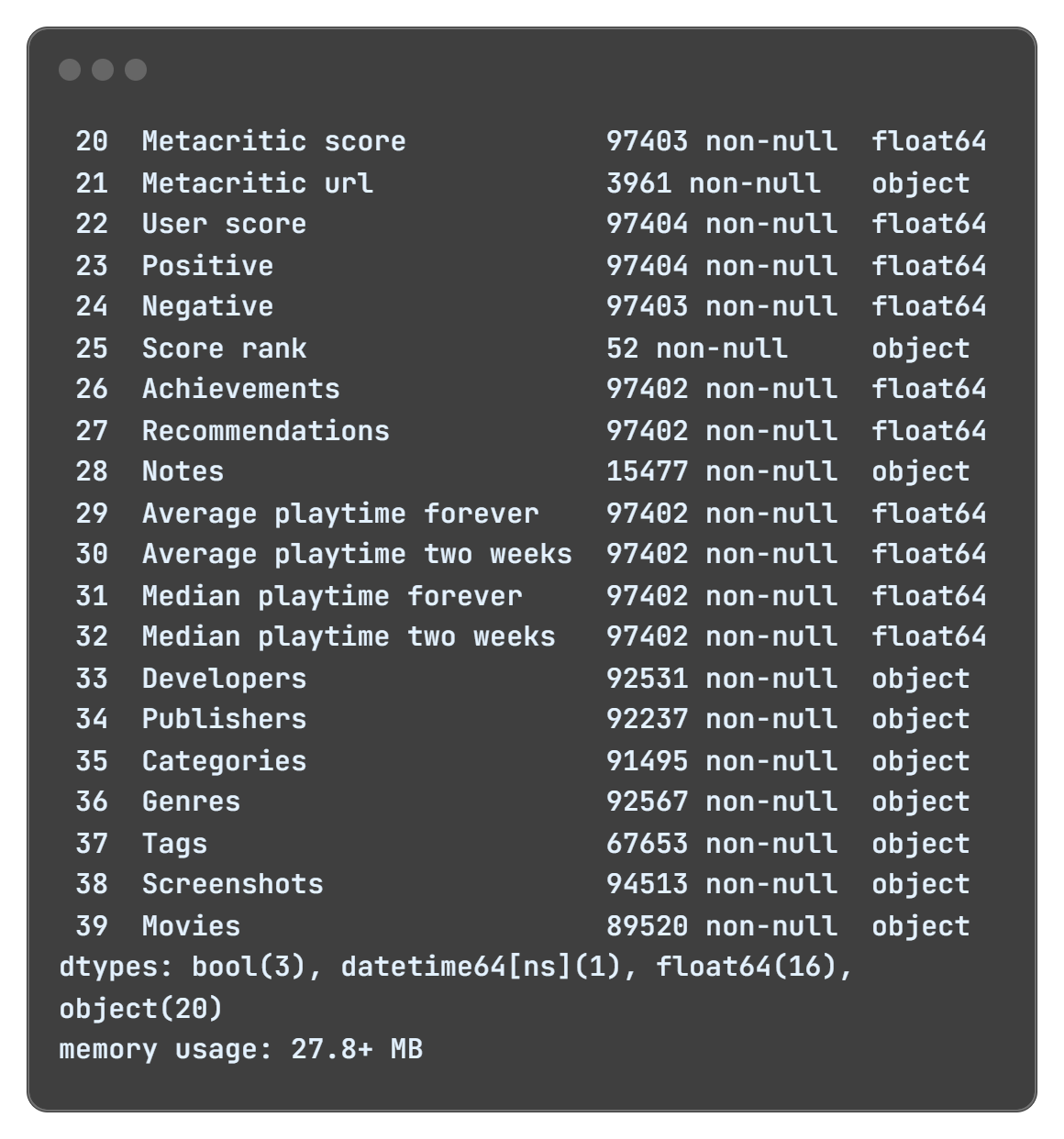
Data Overview and Missing Values
(df.info()): This command provides a detailed summary of the dataset, including the number of entries, the data types of each column, and how many non-null values are present.
Prafful Singh

Slide 14

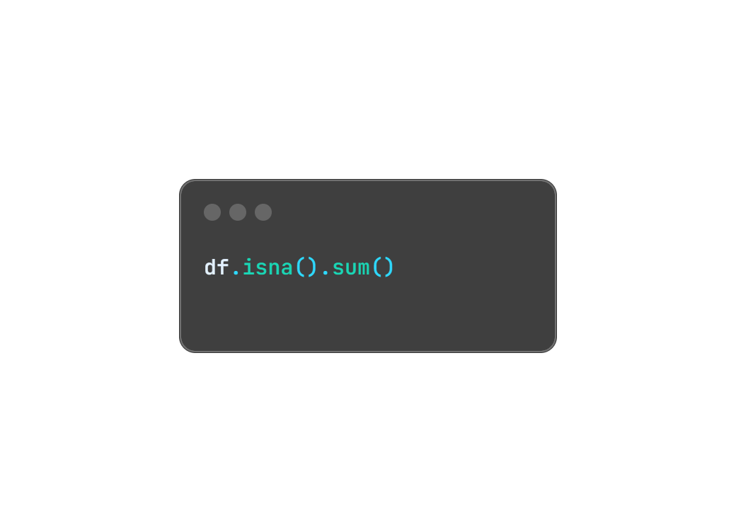
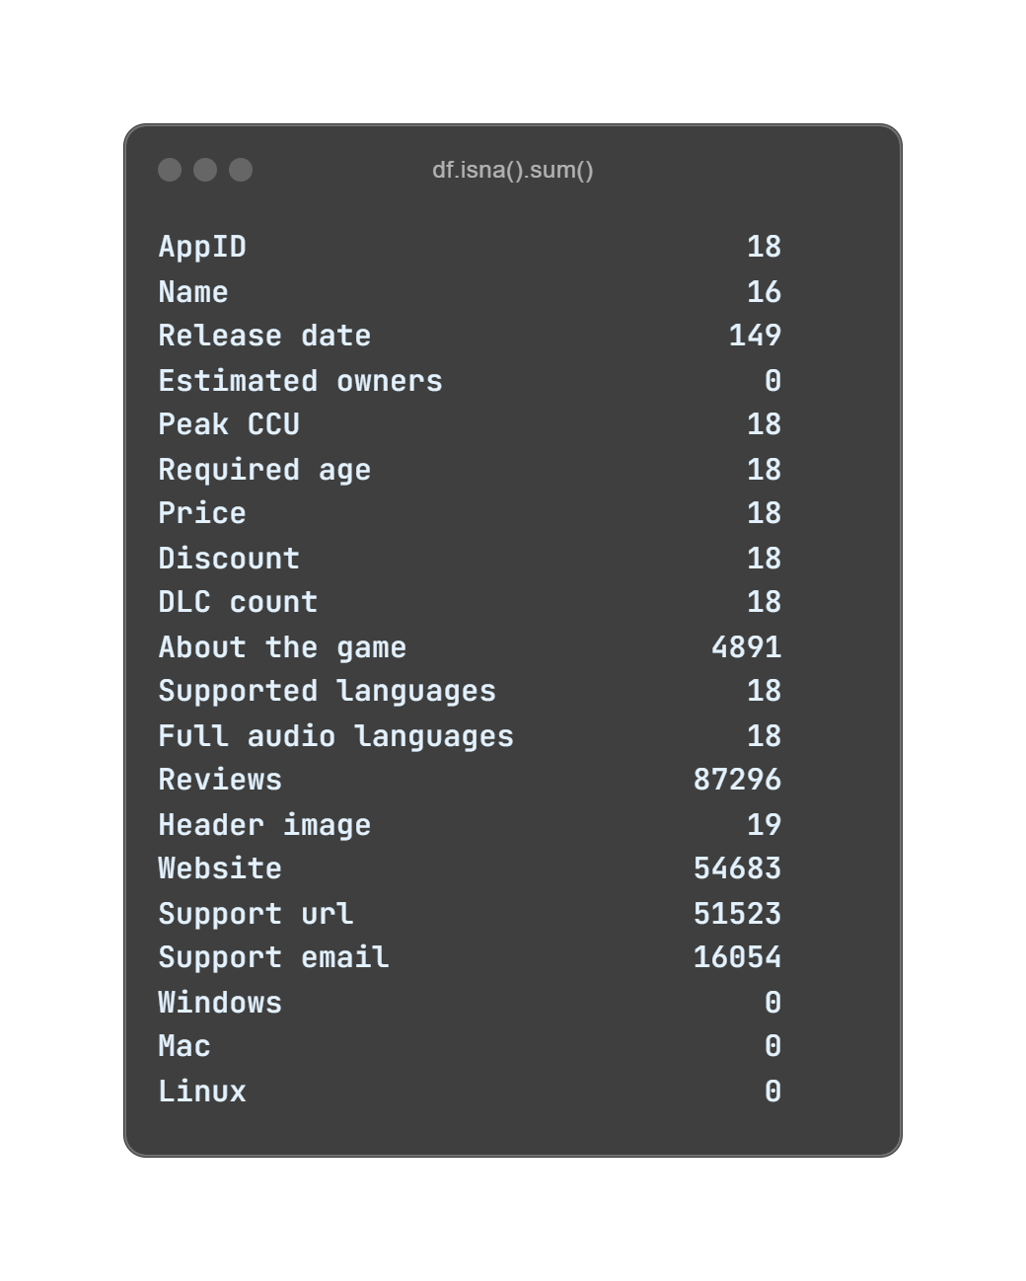
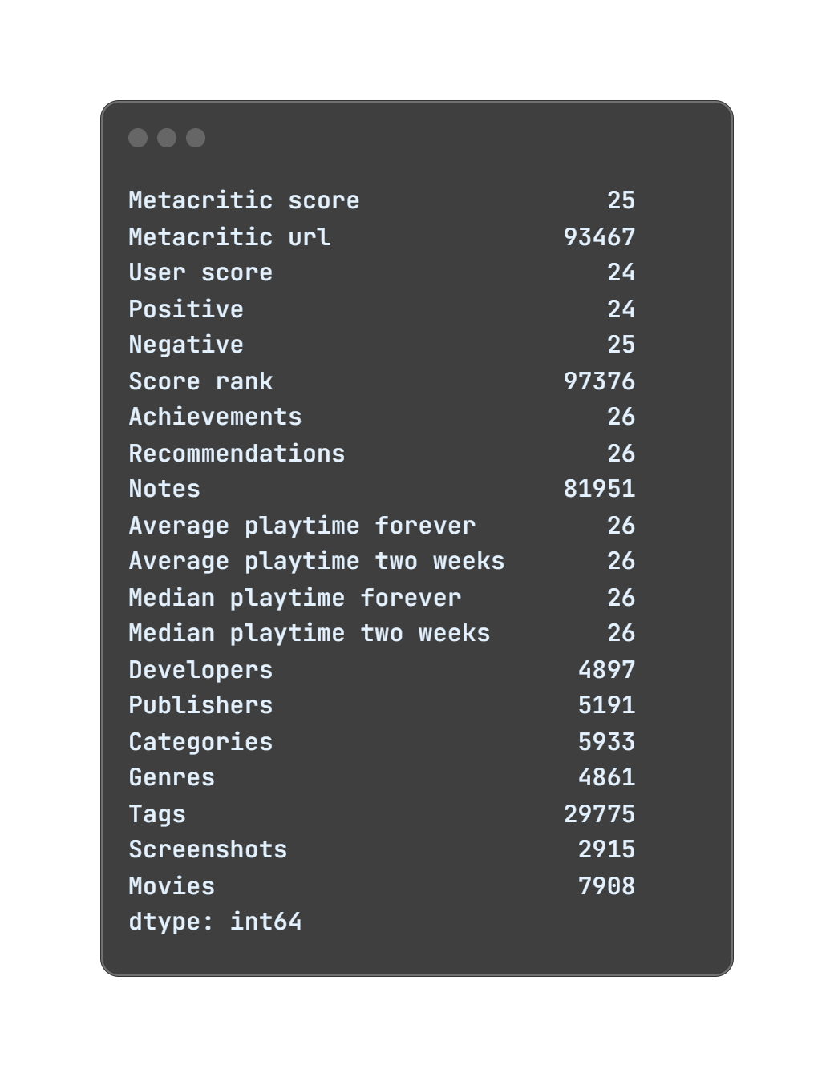
Missing Values Analysis
This step calculates the number of missing (NaN) values in each column, giving a clear view of where data is incomplete. Identifying missing data is essential for deciding how to handle it, whether through imputation, removal, or other data cleaning methods.
Prafful Singh

Slide 15

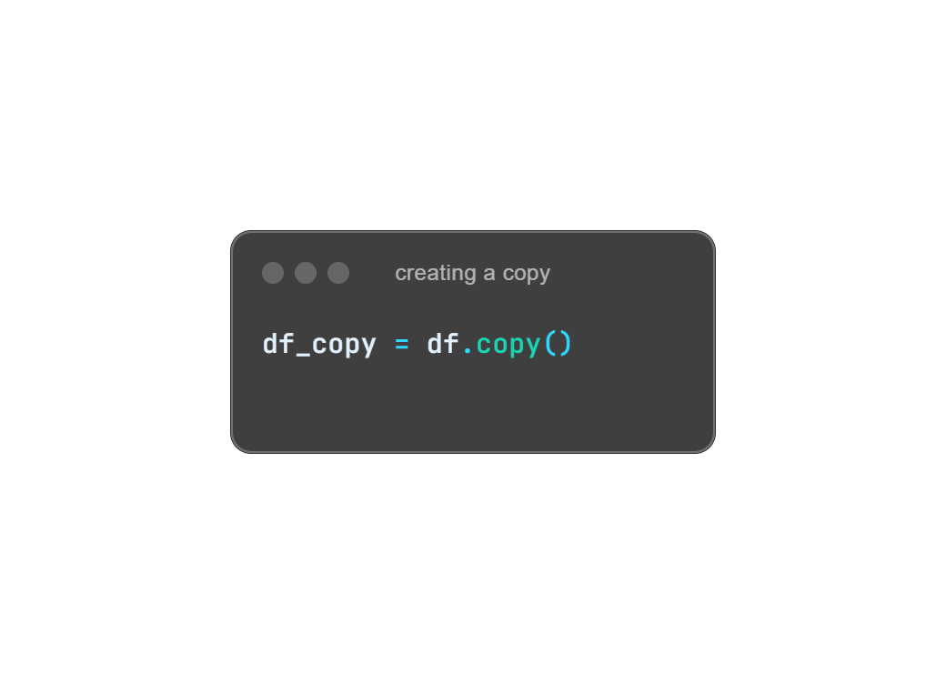
Data cleaning
Data cleaning is a crucial step in ensuring the dataset is accurate, consistent, and free from errors. This process involves handling missing values, correcting data types, and addressing inconsistencies. By cleaning the data, we enhance the quality and reliability of the analysis, leading to more accurate insights.
Why Data Cleaning Matters:
Ensures data consistency and accuracy.
Helps prevent skewed analysis due to erroneous or incomplete data.
Improves model performance and overall data quality.
As a best practice, I created a copy of the original dataset to maintain data integrity during cleaning.
Prafful Singh

Slide 16

Looks like there’s some incomplete data. How will you handle this?
I’ll clean it by removing rows with critical missing information and making adjustments so the dataset remains reliable for analysis.
What’s your approach for columns with a lot of missing data, like 'Reviews' or 'Supported Languages'?
I’ll either clean or drop them based on relevance. For example, we’ll remove non-essential columns like ‘Reviews’ that aren’t critical to our insights.
Prafful Singh

Slide 17

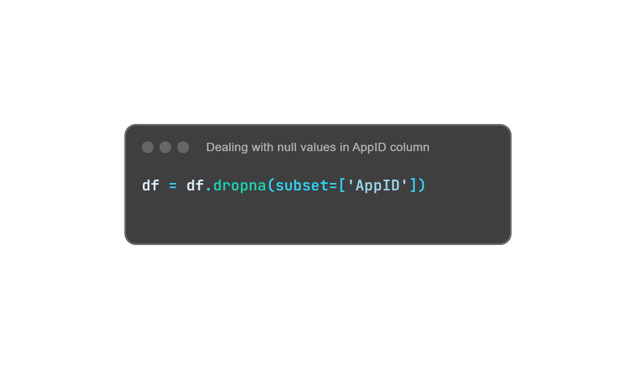
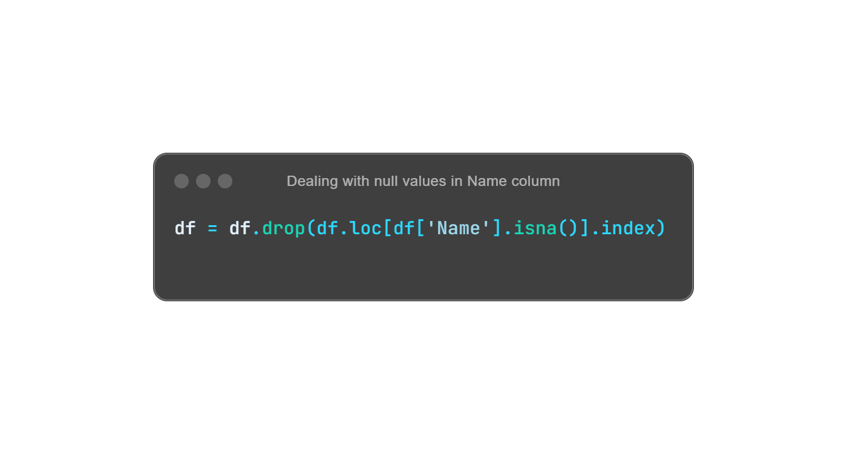
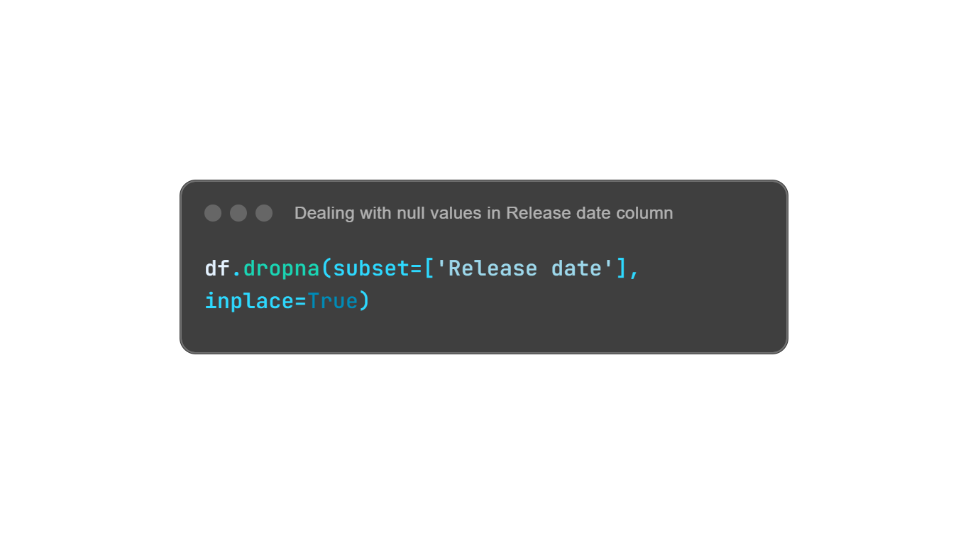
Handling Missing Values
Dealing with missing values is a critical aspect of data cleaning. In this step, I focused on removing rows with missing data in key columns, ensuring the dataset remains reliable for analysis.
AppID Column:
I identified 18 rows with missing values in the 'AppID' column and removed them, as this column serves as a unique identifier, making it crucial for every row.
Name Column:
6 rows with missing values in the 'Name' column were dropped,
as the game names are essential for identification and analysis.
Release Date Column:
131 rows had missing 'Release Date' values. Since this accounts for only a small fraction (0.14%) of the dataset, I dropped these rows. Filling them with estimates wouldn't provide meaningful insights, and removing them keeps the dataset clean and accurate.
Prafful Singh

Slide 18

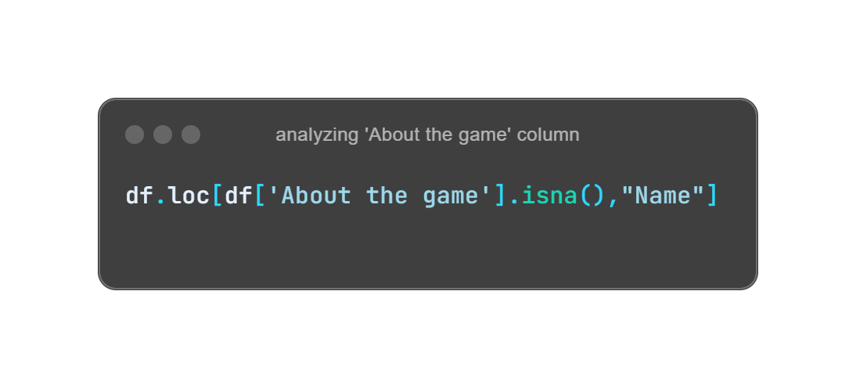
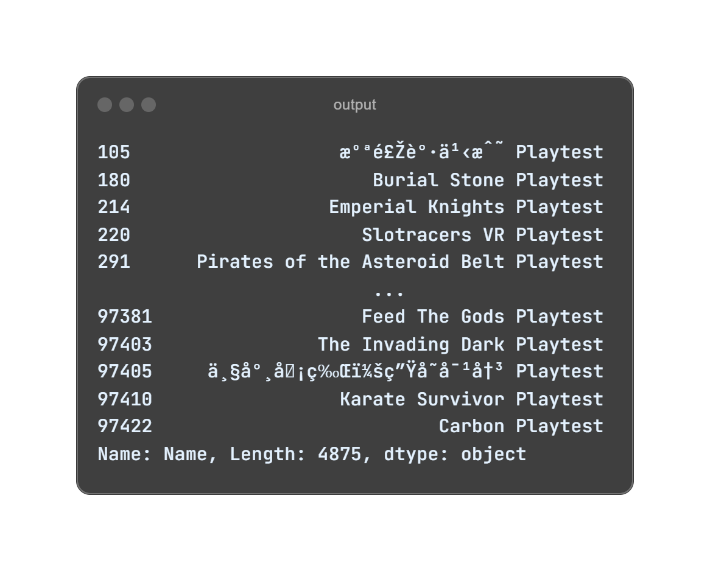
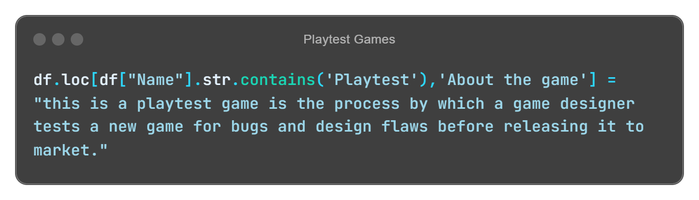
Handling Missing Values in 'About the Game' Column
I identified patterns in the data and applied specific descriptions to games based on their type.
Here's the approach:
Playtest Games: Most missing descriptions were for Playtest games. I replaced these with:
"This is a playtest game and is the process by which a game designer tests a new game for bugs and design flaws before releasing it to market."
Prafful Singh

Slide 19

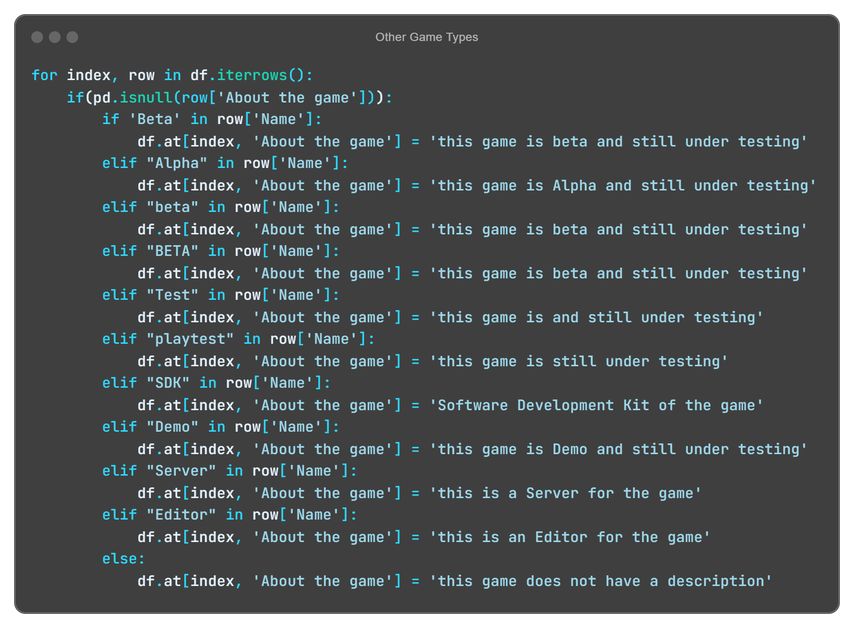
Other Game Types: For remaining missing values (237 games left), I replaced them based on game types found in the 'Name' column:
Beta: "This game is beta and still under testing"
Alpha: "This game is alpha and still under testing"
Test: "This game is under testing"
SDK: "Software Development Kit of the game"
Demo: "This game is demo and still under testing"
Server: "This is a server for the game"
Editor: "This is an editor for the game"
Prafful Singh

Slide 20

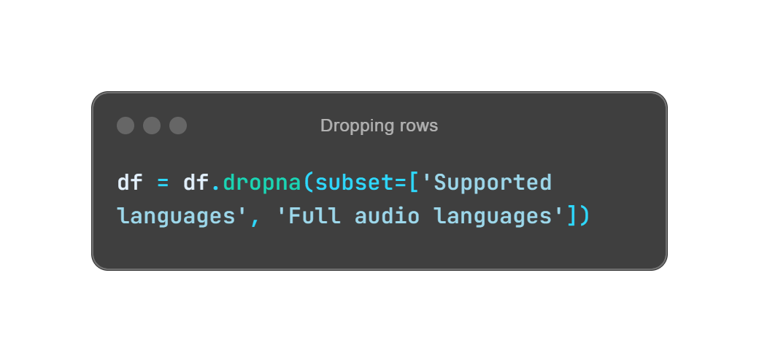
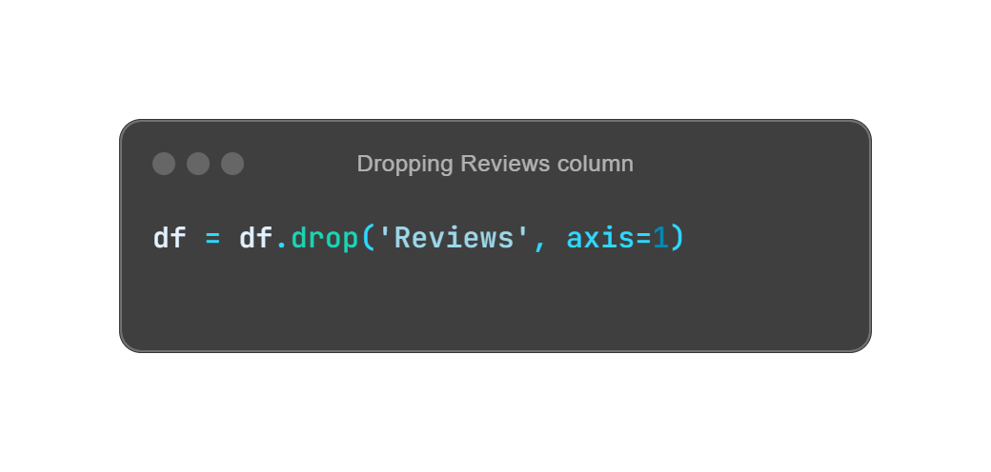
Handling Missing Values in 'Supported languages’, 'Full audio languages' Columns and 'Reviews' Column
Upon analysis, I found that:
There were 8 rows with missing data in either the 'Supported languages' or 'Full audio languages' columns.
Further inspection revealed that these rows contained many null values across other columns as well.
Since these rows had multiple missing values and these two columns aren't critical to the core analysis, I decided that dropping these rows would be the most efficient and cleanest solution.
The 'Reviews' column had a significant number of missing values (87,165). Since:
The proportion of missing data was too large to impute accurately.
The 'Reviews' column is not central to the objectives of this analysis.
I chose to drop the entire 'Reviews' column from the dataset.
Prafful Singh

Slide 21

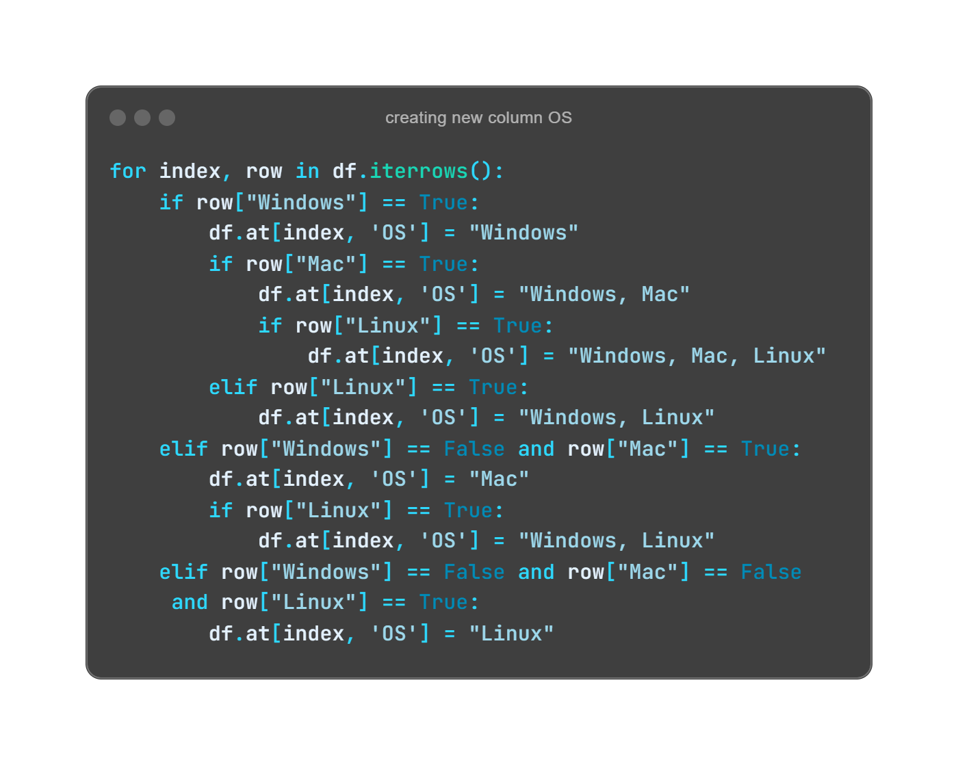
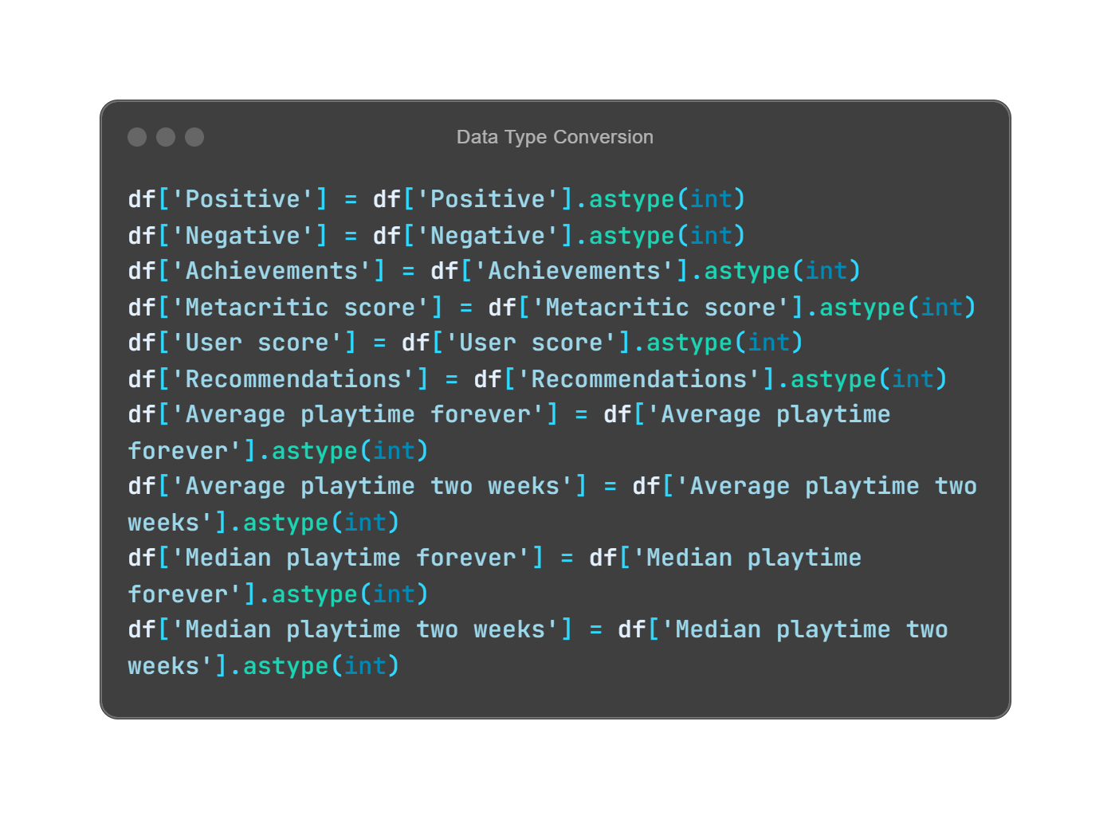
Creating OS Columns and Data Type Conversion
To streamline the dataset, I merged the Windows, Mac, and Linux columns into a single column, 'OS', representing the supported operating systems for each game. This provides a cleaner and more efficient structure for analysis.
Additionally, I converted several columns to the integer data type after handling null values. This ensures that future calculations and visualizations work seamlessly.
Prafful Singh

Slide 22

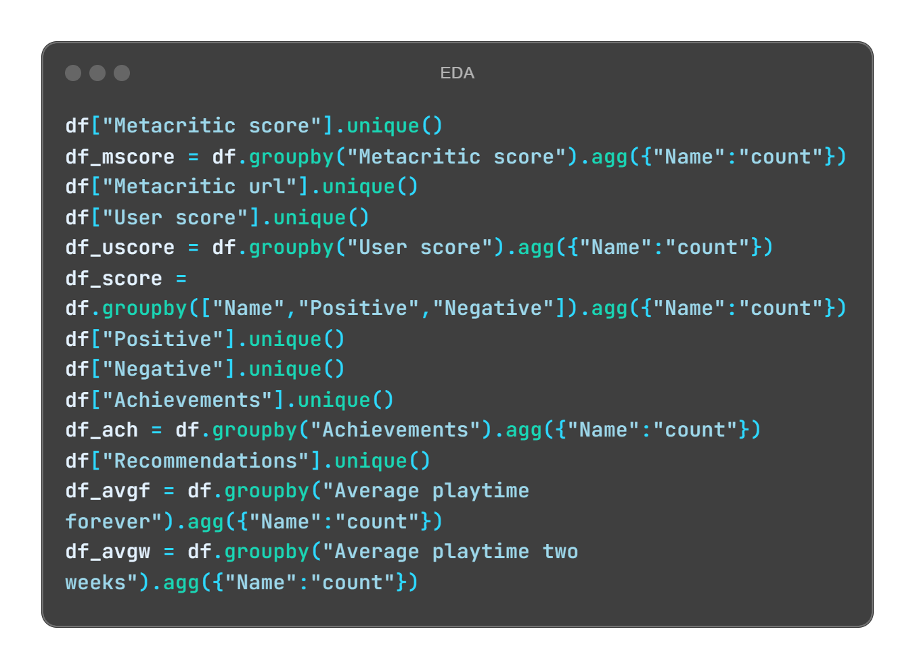
Initial Data Exploration
In this step, I explored various game performance metrics and their distribution across the dataset. I focused on:
Metacritic Score: Grouped games by their Metacritic scores and counted the number of games corresponding to each score.
User Score: Similar to Metacritic scores, grouped games by user scores and analyzed the count.
Positive and Negative Reviews: Grouped games based on the number of positive and negative reviews to gain insights into user feedback.
In-game Achievements: Analyzed the number of in-game achievements for each game.
Playtime: Investigated the distribution of both "Average playtime forever" and "Average playtime in two weeks" to see how much time players are spending on games.
This exploration provides an overview of how various metrics like scores, reviews, and playtime are distributed across the dataset.
Prafful Singh

Slide 23
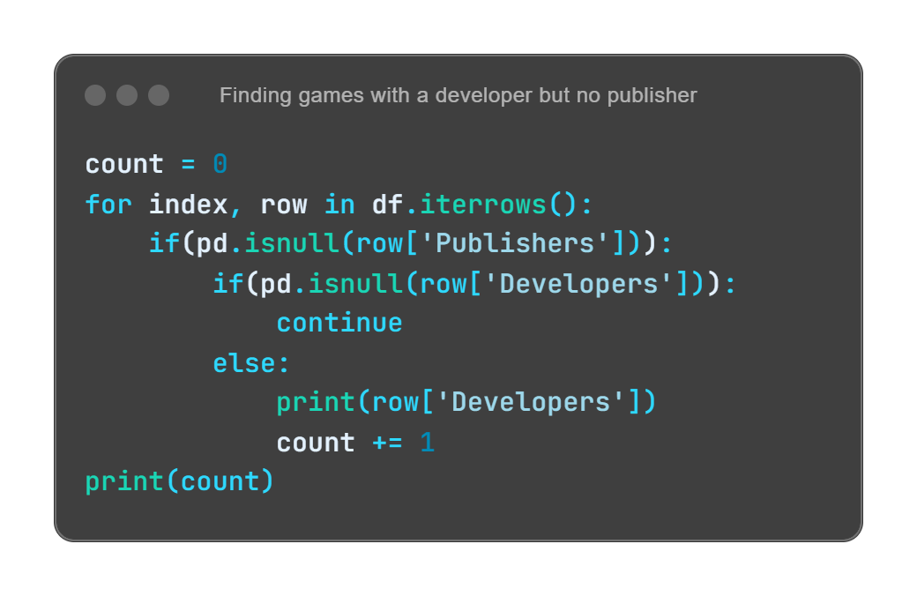

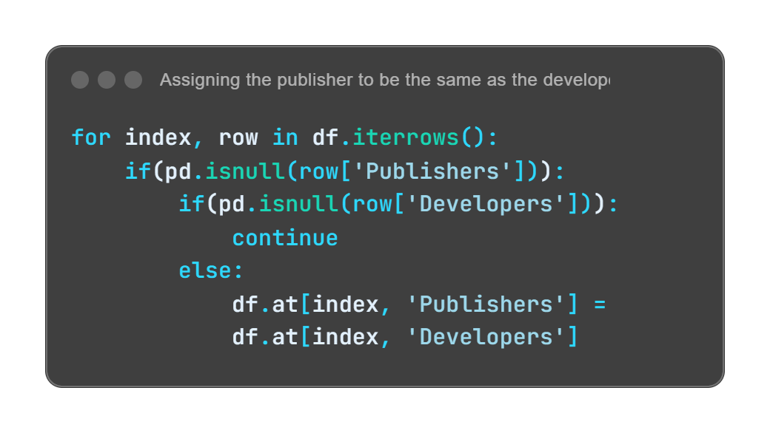
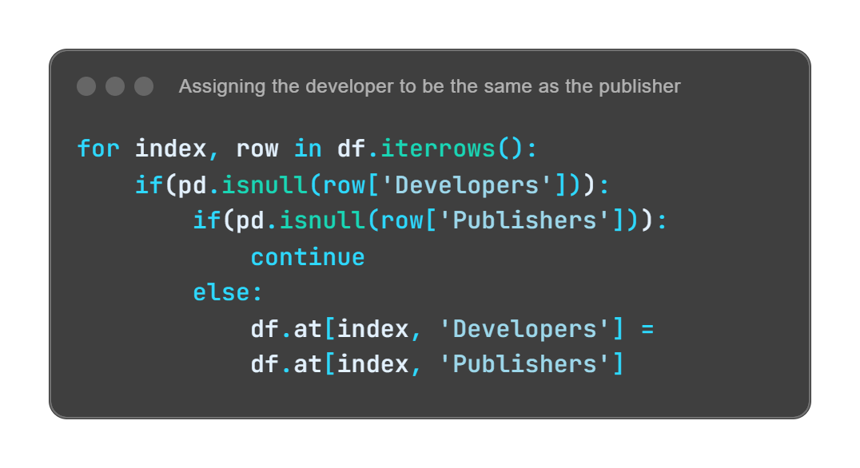
Cleaning Developers and Publishers Columns
Initial Exploration: I first checked the uniqueness of developers and publishers and found some missing values in both columns.
There were:
350 games where the developer was mentioned, but the publisher was not.
58 games where the publisher was mentioned, but the developer was not.
Handling Missing Values:
For the 350 games, I assigned the same value from the 'Developers' column to the 'Publishers' column.
For the 58 games, I assigned the same value from the 'Publishers' column to the 'Developers' column.
Prafful Singh

Slide 24

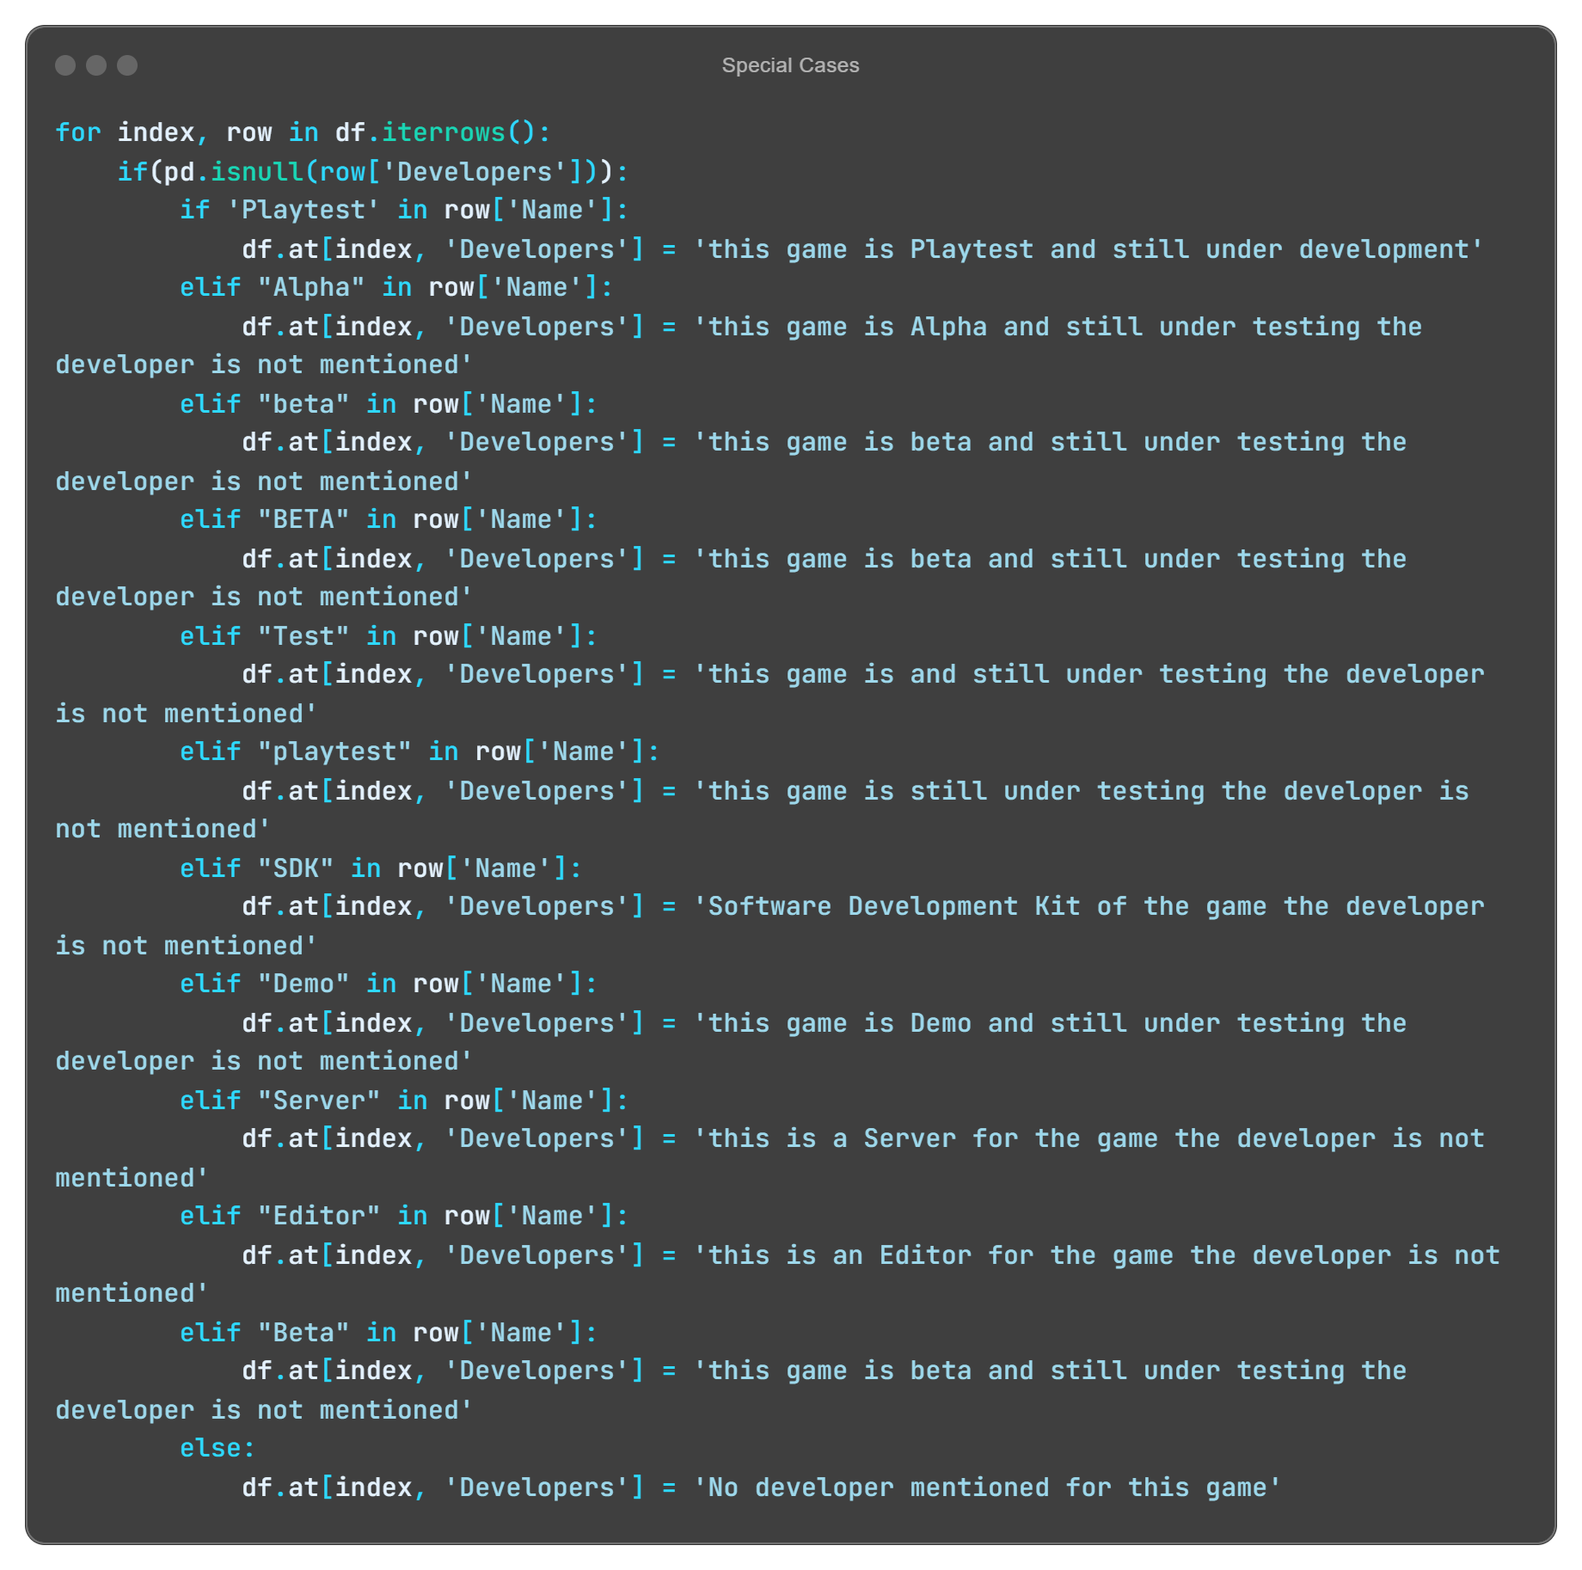
Special Cases: I identified specific games (e.g., Beta, Demo, SDK) where both developers and publishers were not mentioned. I replaced missing values in these cases with context-appropriate descriptions such as:
"This game is Playtest and still under development."
"This game is Alpha and still under testing; the developer is not mentioned.“
This ensured that games in early stages of development were properly documented.
Similarly, for the 'Publishers' column, missing values were handled by applying the same logic used for 'Developers', with appropriate descriptions based on the game type.
This process helped in filling missing values systematically, retaining data consistency for both developers and publishers.
Prafful Singh

Slide 25

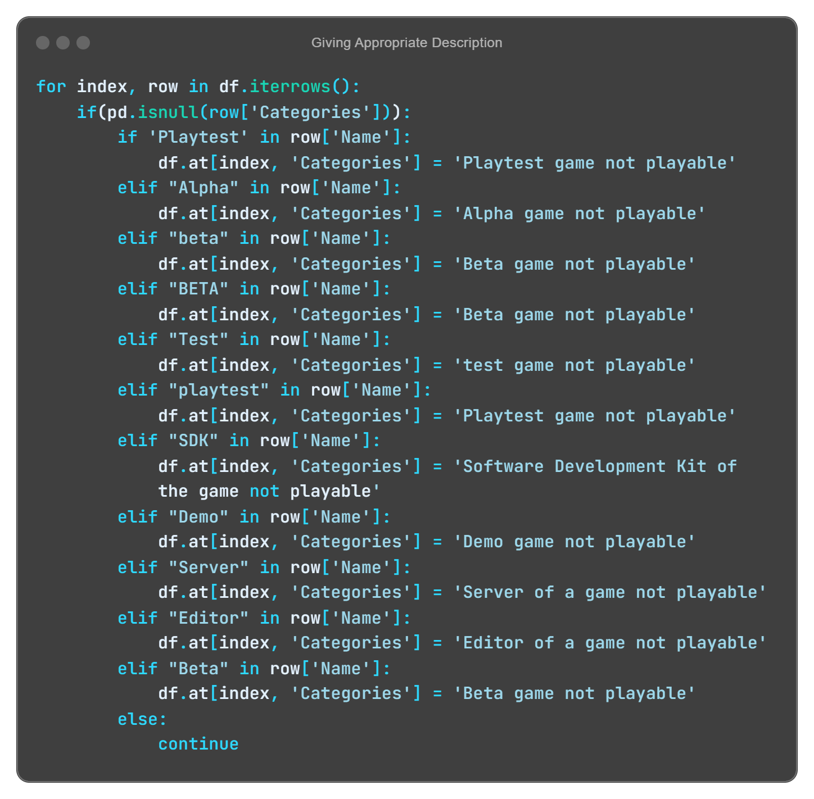
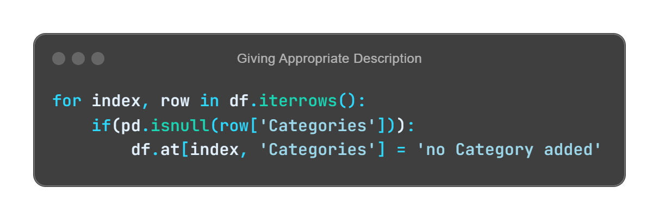
Handling Missing Data in 'Categories' Column
Explored the Categories column and identified recurring keywords such as Playtest, Alpha, Beta, SDK, and others.
Based on the type of game, missing values were replaced with appropriate descriptions like:
‘Beta game not playable', 'Alpha game not playable', 'Playtest game not playable', and similar labels for other game types.
After applying this approach, very few games were left with missing categories.
Any remaining games without category information were assigned the label 'no Category added’.
A similar approach is applied to the 'Genres’, ‘Movies’ and ‘Support email’ column
Prafful Singh

Slide 26

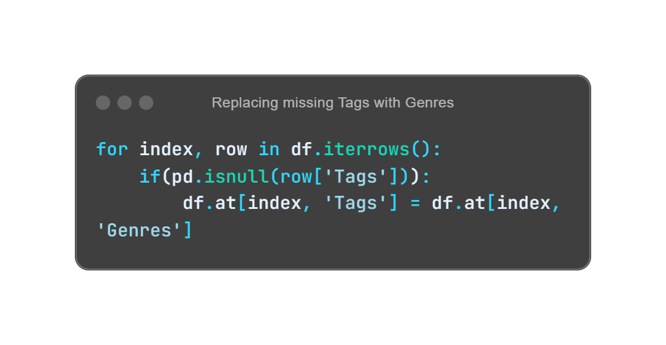
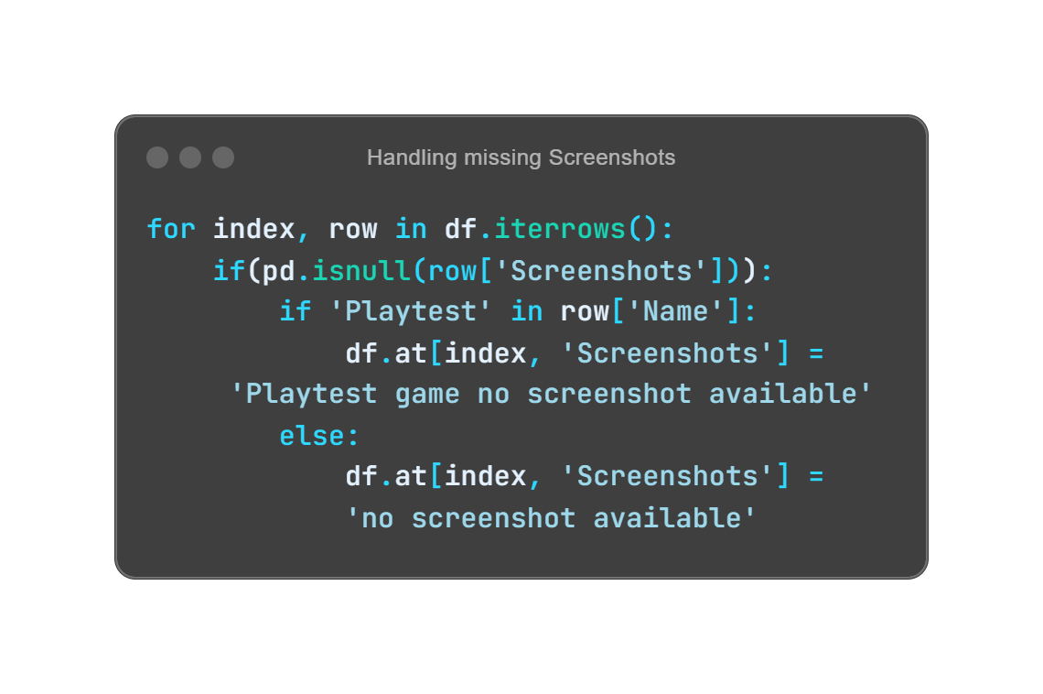
Cleaning Tags and Screenshots Columns
Upon analysis, I noticed that:
The Tags for each game often mirrored the Genres. To enhance data consistency, I replaced any missing Tags with the corresponding Genres. This ensures that even if tags are not explicitly provided, the dataset retains relevant classification for each game.
For the Screenshots column, I found that Playtest games frequently lacked screenshots. To address this,
I implemented a specific replacement strategy:
For Playtest games, missing screenshots were labeled as "Playtest game no screenshot available."
For all other games without screenshots, I used the label "no screenshot available."
This approach not only fills in gaps but also maintains clarity in the dataset, allowing for more accurate and meaningful analyses in subsequent steps.
Prafful Singh

Slide 27


Do we need all these columns? Let’s focus on what’s really important.
Exactly! I’ll remove redundant columns that don’t contribute much, streamlining the dataset for better insights.
Prafful Singh

Slide 28

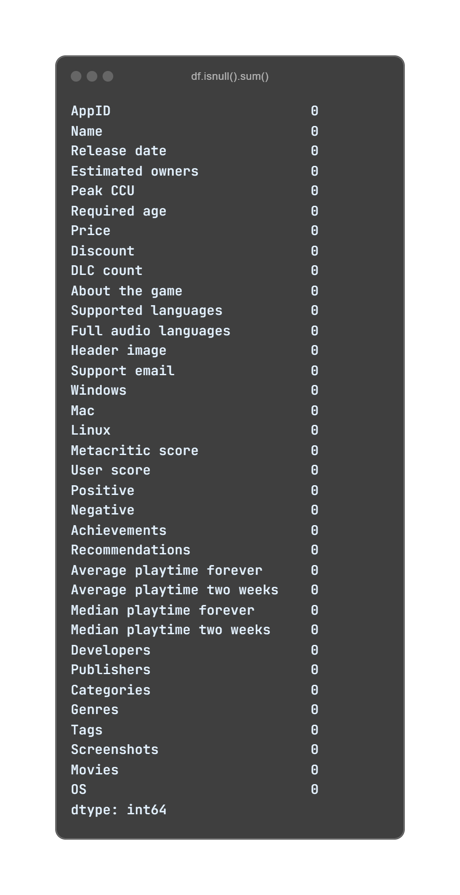
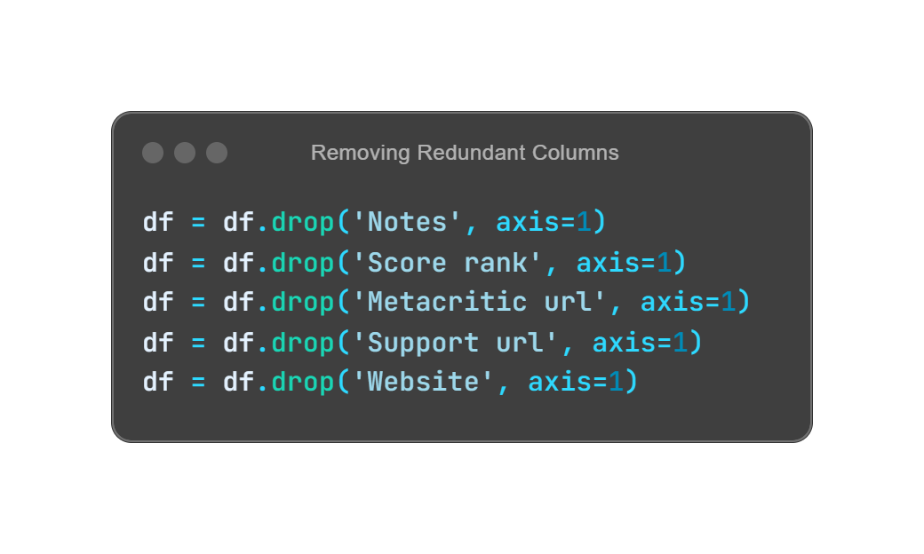

Removing Redundant Columns
To enhance the quality of my dataset, I conducted a thorough review and identified specific columns that had over 50% missing values, which were:
Notes
Score rank
Metacritic url
Website
Support url
Recognizing that these columns did not contribute valuable insights for my analysis, I decisively removed them to maintain a clean and focused dataset.
After this cleanup, I verified the dataset’s integrity, confirming that all remaining columns are free of null values
The updated summary indicates that there are 0 null values in all remaining columns, ensuring a robust dataset ready for analysis.
Prafful Singh

Slide 29
Great job with the data cleaning! Now, I’m excited to see what insights we can gather to improve our game marketing strategies.
Let’s dive into the visualizations and I’ll show you key trends that will help drive your campaigns.
Prafful Singh

Slide 30

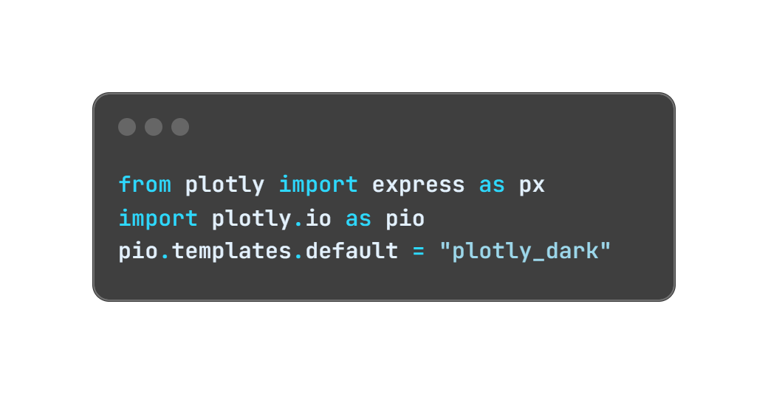
Data Visualization
Why Data Visualization Matters:
Reveals hidden patterns and trends: Helps uncover insights that may not be visible in raw data.
Simplifies complex datasets: Breaks down large datasets into intuitive, understandable graphics.
Facilitates decision-making: Presents data in an accessible way for both technical and non-technical audiences.
Enhances communication: Visuals effectively communicate insights, making it easier to explain trends and drive conclusions.
Supports storytelling: Transforms data into a narrative, helping to tell a compelling story through graphics.
I decided to use a visually consistent dark theme for all my plots to make them more striking and professional. To achieve this, I used Plotly's dark mode feature by adding the following code:
Prafful Singh

Slide 31
Which games are the most popular in terms of downloads? This could help us focus our marketing efforts
Absolutely! Let me show you the top 10 most downloaded games on Steam.
Interesting! What about the most expensive games? Are they performing as well as the popular ones?
Yes, let’s explore how the priciest games are doing and whether they’re worth extra promotion
Prafful Singh

Slide 32

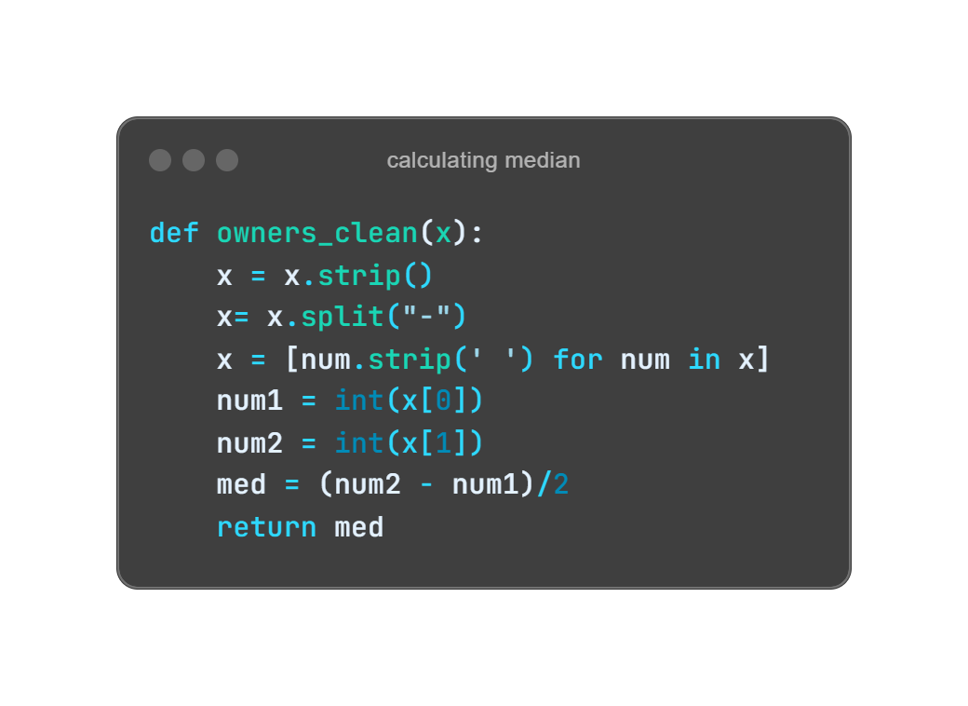
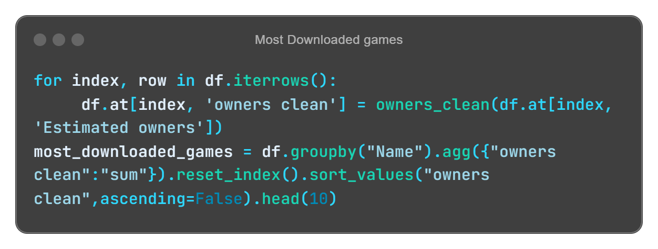
Most Downloaded Games
I analyzed the most downloaded games based on the Estimated Owners column, which provided ownership ranges. To make the data more usable, I created a function, owners_clean(), to calculate the median value of each range. This involved splitting the range, converting it to integers, and computing the median.
Next, I applied this function to each row, creating a new column, owners clean. Using the groupby method, I aggregated and summed the median owners for each game, then sorted the data to highlight the top 10 most downloaded games.
Prafful Singh

Slide 33


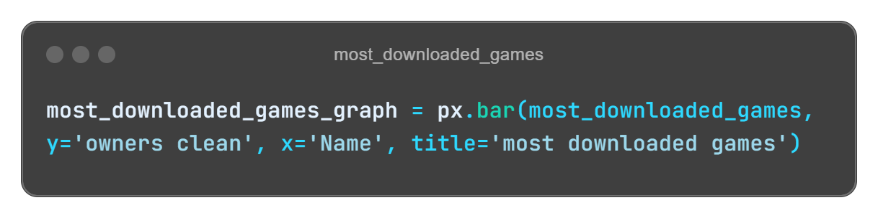
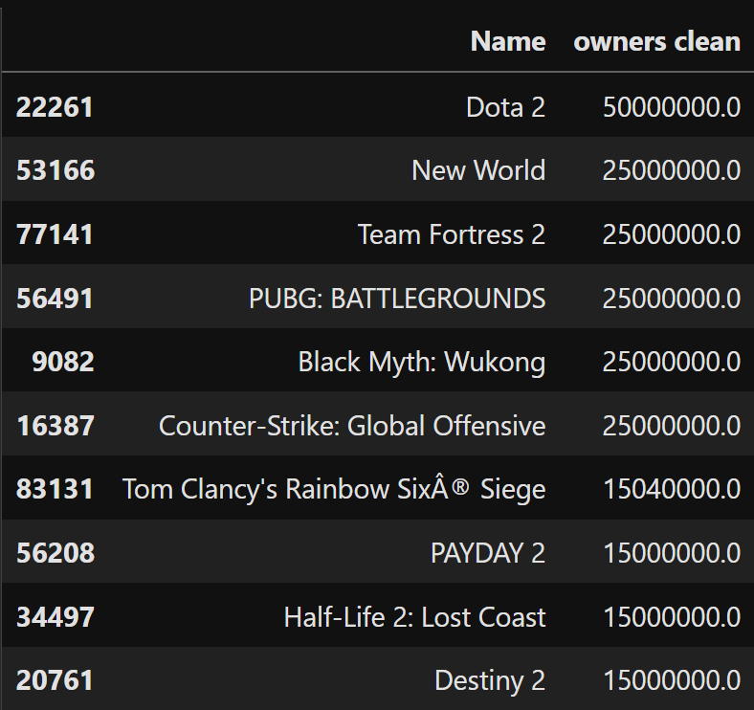
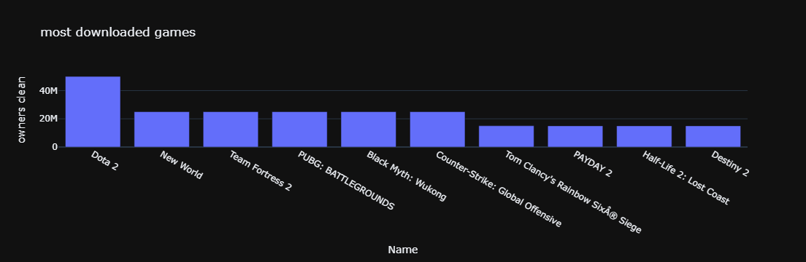
Visualization: To visualize this, I created a bar chart using Plotly, displaying the top 10 most downloaded games. The games are plotted on the x-axis, while their respective owner counts are on the y-axis.
Key Results:
Dota 2 topped the list with an estimated 50 million owners.
Other popular games included New World, Team Fortress 2, PUBG: BATTLEGROUNDS and Black Myth: Wukong each with 25 million owners.
Prafful Singh

Slide 34

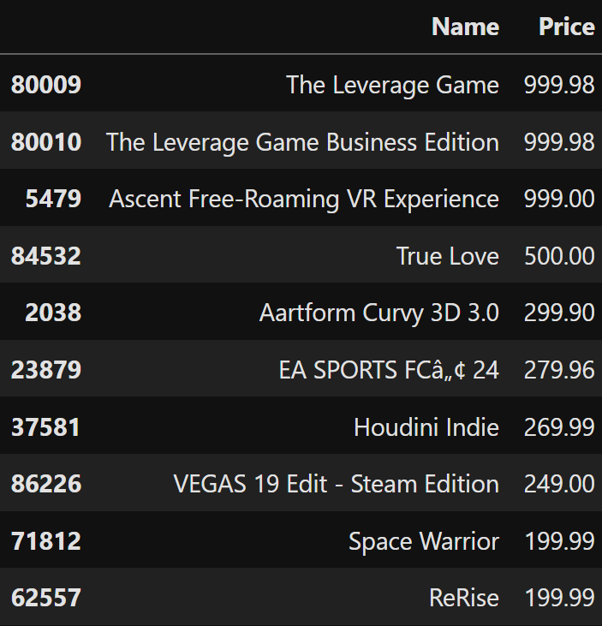
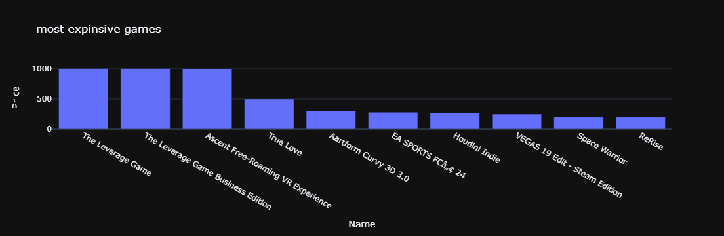
Most expensive games
In this analysis, I identified the most expensive games by aggregating the Price column. Using the groupby method, I summed the prices for each game and sorted the results in descending order. This highlighted the top 10 most expensive games, providing insight into their high price points. A bar chart was created to visually represent these prices for easy comparison.
Key Insights:
The Leverage Game and Ascent Free-Roaming VR Experience stand out with price points nearing $1,000, indicating a niche market for premium gaming experiences.
The chart provides a clear visual comparison, making it evident how some games command significantly higher prices, likely due to their unique content or production quality.
Prafful Singh

Slide 35

Now that we know the most downloaded and most expensive games, how do price and downloads correlate?
Let’s take a look at how price affects downloads and see if we can spot any trends for free vs. paid games
Also are free games getting more downloads than paid ones? This is critical for our campaign strategies
Yes, let’s explore the data to compare how free and paid games perform in terms of downloads.
Prafful Singh

Slide 36


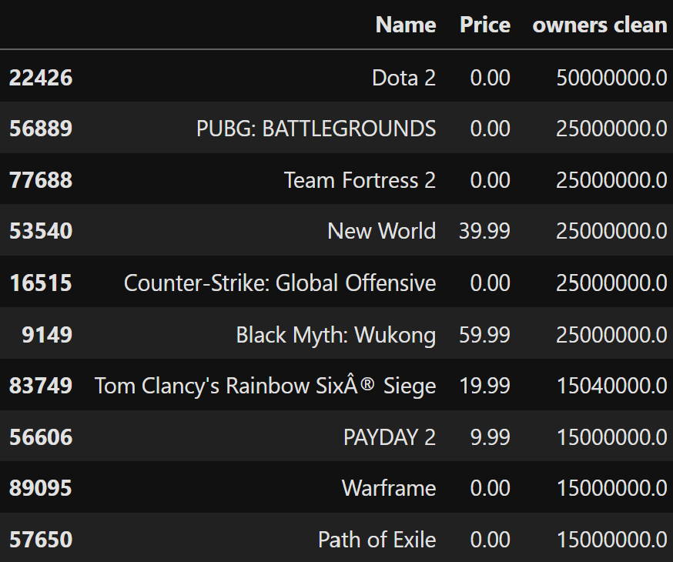
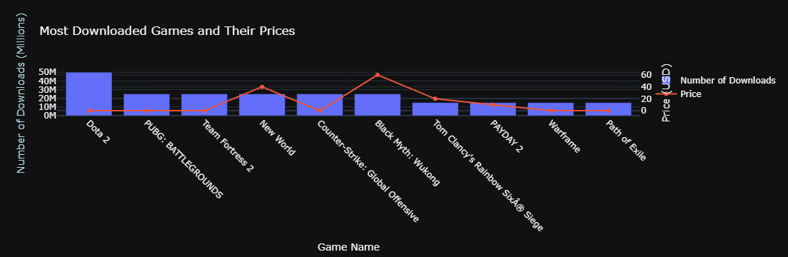
Most Downloaded Games and Their Prices
In this analysis, I explored the most downloaded games alongside their prices. By aggregating the total number of downloads and sorting the data, I identified the top 10 games by popularity.
Key Insights:
Dota 2 leads with 50 million downloads, while several games like PUBG: BATTLEGROUNDS and Team Fortress 2 also show significant popularity despite having a zero price tag.
The visualization highlights how price impacts game popularity, showcasing a mix of free-to-play and premium titles.
Prafful Singh

Slide 37

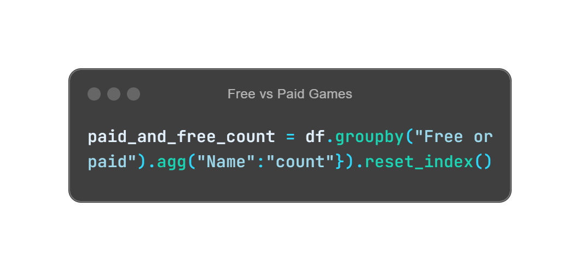
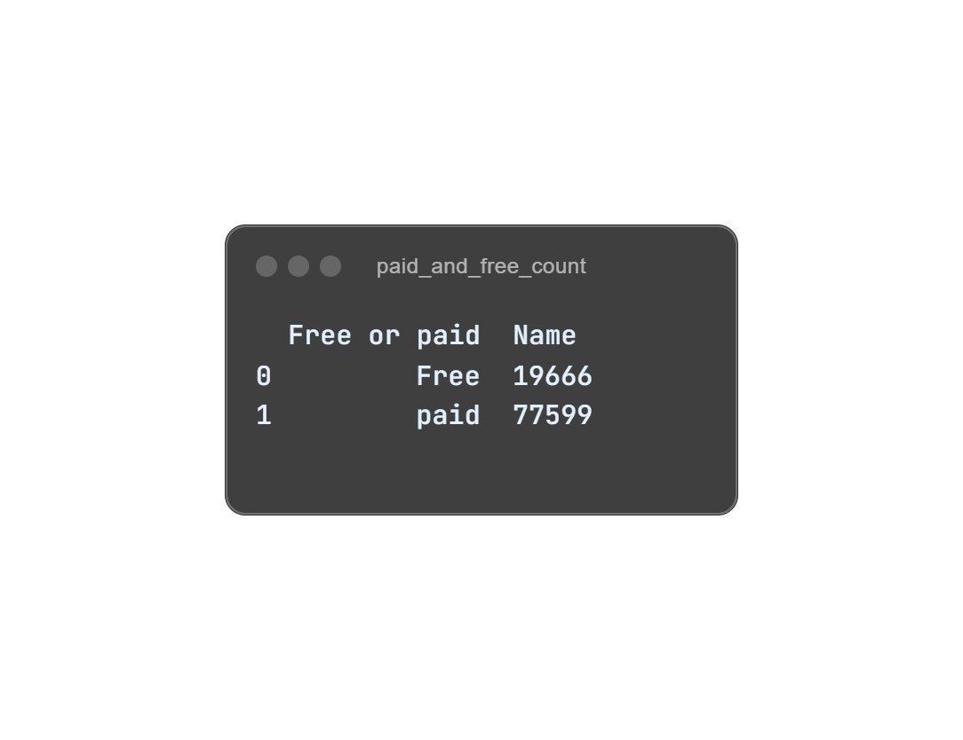
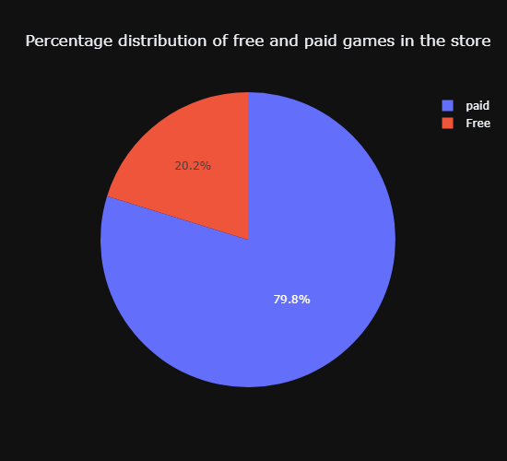
Prices Distribution
In this segment, I examined the distribution of game prices using a box plot to identify the range and outliers within the dataset.
Key Insights:
The box plot reveals that while many games are priced affordably, there are also significant outliers indicating a presence of premium titles.
Following the price analysis, I categorized the games into "Free" and "Paid" based on their price points, finding a substantial majority of paid games compared to free ones.
To visualize this distribution, I created a pie chart illustrating the percentage distribution of free and paid games in the store.
Prafful Singh

Slide 38

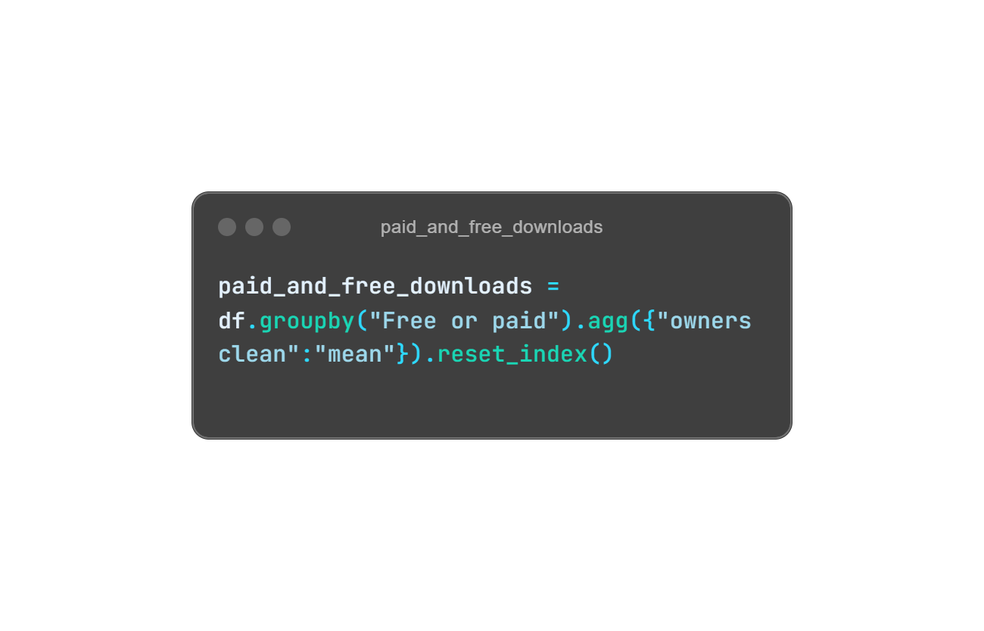
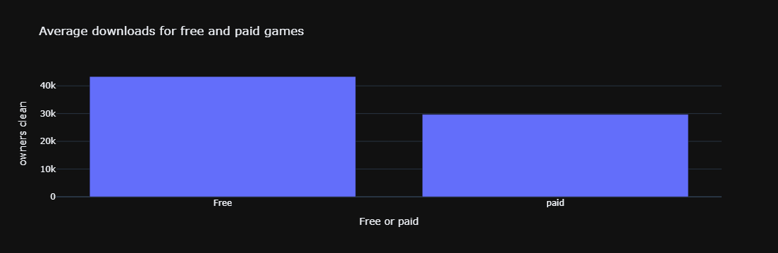
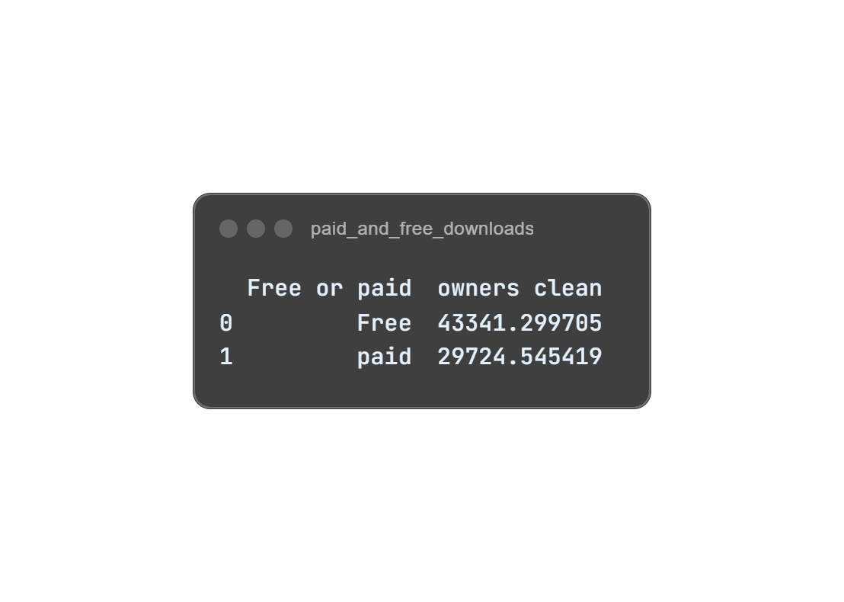
Average downloads for free and paid games
I further analyzed the average downloads for both free and paid games to understand their popularity and market engagement.
Key Insights:
The average number of owners for free games is significantly higher (approximately 43,341) compared to paid games (around 29,725), indicating that free games attract a larger player base.
This suggests that while free games may drive more downloads, paid games might struggle to match that engagement, highlighting different market dynamics between free-to-play and paid models.
Prafful Singh

Slide 39

How does localization impact downloads?
I want to see which languages are most commonly supported.
Let’s look at the data on supported languages and see which ones help drive downloads.
Do games that support multiple operating systems get more downloads? Should we target specific platforms?
Good question! Let’s also analyze how downloads vary based on the operating system support.
Prafful Singh

Slide 40
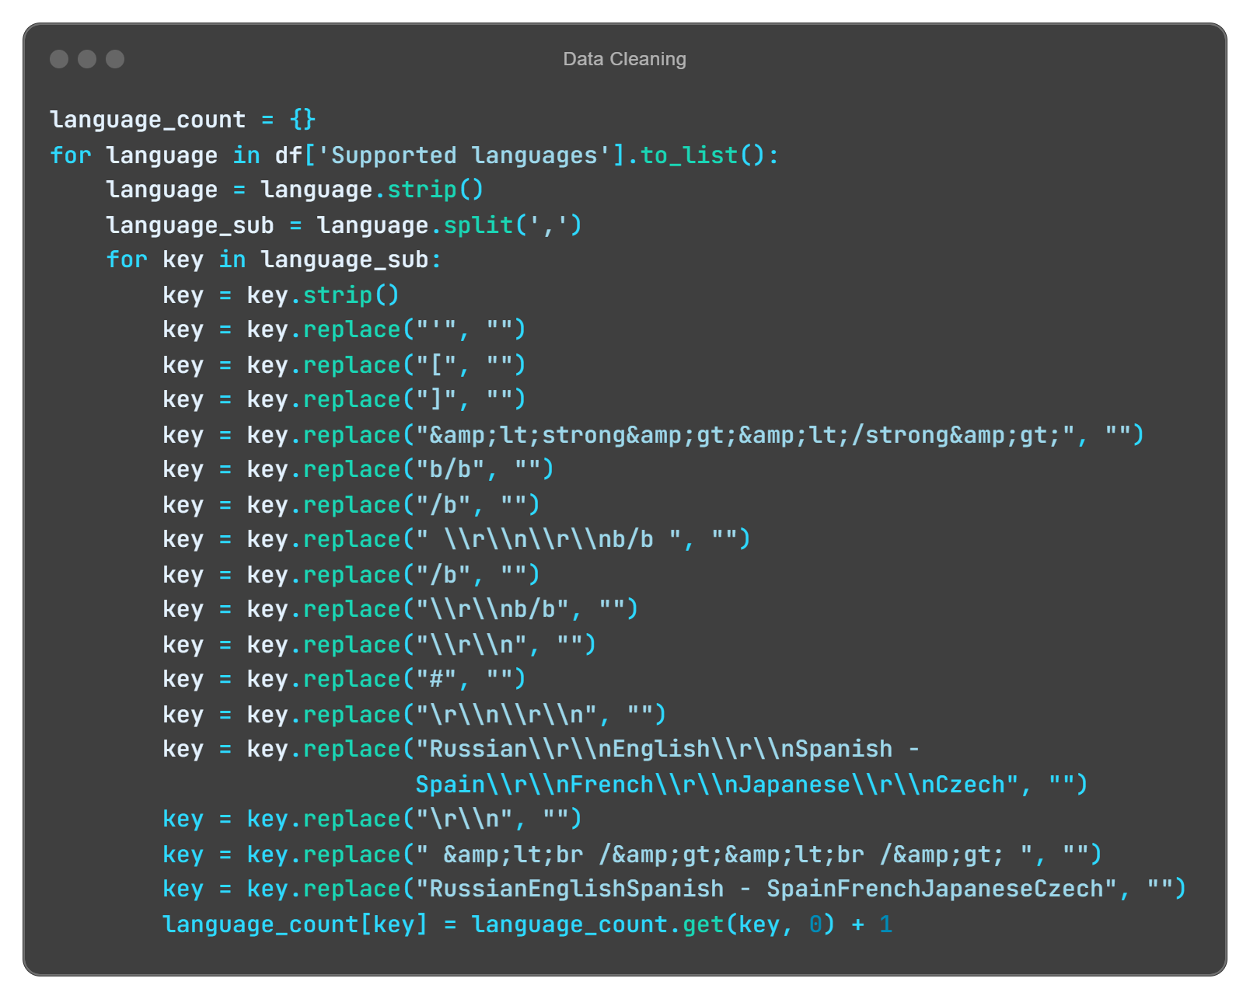
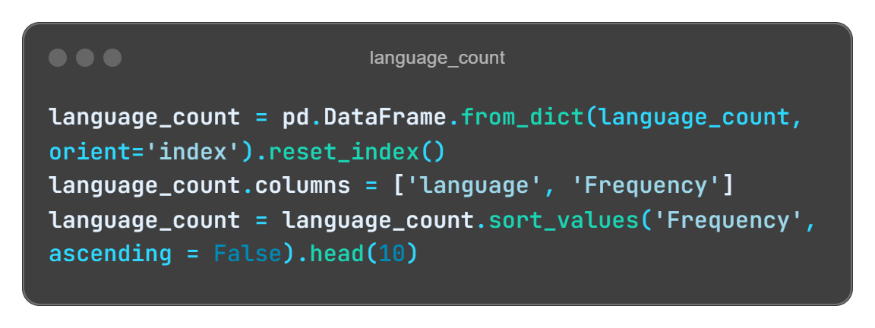
Most Supported languages
In this analysis, I examined the most supported languages in the dataset, focusing on the "Supported languages" column. Here’s how I processed the data:
Data Cleaning: I created a dictionary to count the occurrences of each language, stripping extra spaces and removing unnecessary characters from the language strings. This ensured accurate language representation.
Aggregation: After processing, I converted the language count dictionary into a DataFrame and sorted it to identify the top 10 most supported languages.
Prafful Singh

Slide 41

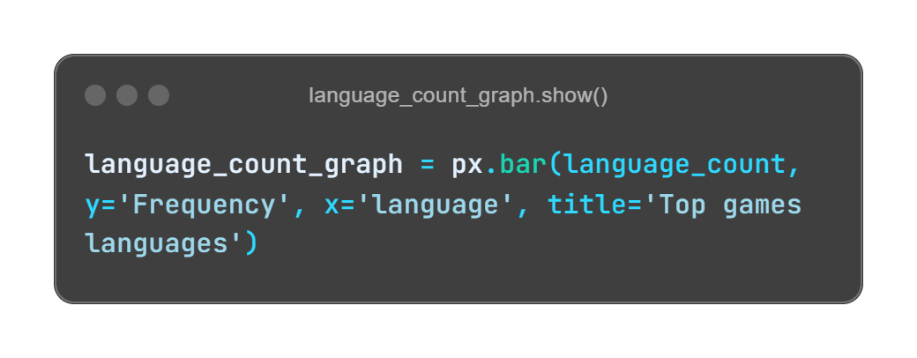


This bar chart illustrates the distribution of the most supported languages in the dataset, highlighting the linguistic diversity in gaming. Understanding this can help developers and marketers target their audience more effectively.
Key Insights:
English Dominance: The analysis revealed that English is the most commonly supported language, with a frequency of 88,121 occurrences, followed by Simplified Chinese and German.
Widespread Localization: Besides English, several other languages, including French, Spanish, and Japanese, have significant support, indicating the global reach and localization efforts of game developers.
Prafful Singh

Slide 42





Average downloads for games with support vs. games without support
In this analysis, I examined the relationship between game support availability and average downloads. By categorizing games based on whether they have a support email, I calculated the average number of owners for both supported and unsupported games.
Key Insights:
Significant Difference: Games without support have a much higher average of approximately 114,776 downloads compared to just 21,761 for games with support. This suggests that users may gravitate towards unsupported games, possibly due to perceived quality or popularity.
Visual Representation: A bar chart effectively illustrates this disparity, making it easy to compare the average downloads for games with and without support at a glance.
Prafful Singh

Slide 43



Average Downloads for Games by Operating System
In this analysis, I explored how the availability of games across different operating systems (OS) impacts their average downloads. By grouping the data based on OS compatibility, I calculated the mean number of owners for each category.
Key Insights:
Windows Dominance: Games compatible with Windows have the highest average downloads, at approximately 33,911, highlighting its strong user base compared to other operating systems.
Multi-OS Advantage: Games that support multiple systems, particularly those that run on both Windows and Mac, see significantly higher average downloads (about 50,236), indicating that broader compatibility may enhance a game’s appeal.
Visual Comparison: A bar chart provides a clear visual representation of average downloads across different OS, facilitating easy comparisons of their popularity.
Prafful Singh

Slide 44

What do the ratings tell us about the best and worst games? This could help us highlight or adjust marketing efforts.
I’ll break down the games with the highest positive and negative ratings to help guide your strategy
Are the most downloaded games also highly rated? Can we spot any trends?
I’ll show you how downloads and ratings are related, which will help us understand user engagement.
Is there a clear relationship between how many downloads a game has and how well it’s rated?
Let’s explore the correlation between downloads and ratings to see what we can uncover.
Prafful Singh

Slide 45



Top Rated Games by Positive and Negative Ratings
In this analysis,
I aggregated the data by game name to sum the positive ratings, allowing me to pinpoint the games with the highest player approval. The same method was applied to determine the games with the most negative ratings.
The results were sorted in descending order, enabling me to easily identify the top-rated games in both categories.
Key Insights:
Top Positive Ratings: Counter-Strike: Global Offensive leads with over 5.76 million positive ratings, followed by Tom Clancy's Rainbow Six® Siege and Dota 2, indicating their strong popularity and user satisfaction.
Prafful Singh

Slide 46





Key Insights:
Top Negative Ratings: Conversely, PUBG: BATTLEGROUNDS has the highest number of negative ratings, reaching nearly 896,000, suggesting significant player dissatisfaction. Notably, Counter-Strike: Global Offensive also appears on this list, highlighting the complexity of player experiences.
Prafful Singh

Slide 47



Most Downloaded Games with Their Positive and Negative Ratings
In this section, I aggregated the data by game name to sum total downloads, positive, and negative ratings, offering a clear view of each game’s popularity and user feedback. Then, I sorted the results by downloads to highlight the top 10 most downloaded games along with their ratings.
Key Insights:
Dota 2 tops the list with 50 million downloads, accompanied by a significant positive rating of 1,477,153, showcasing its popularity among players.
Games like PUBG: BATTLEGROUNDS and Counter-Strike: Global Offensive illustrate the dual nature of player experiences, having high download numbers but also substantial negative ratings. This suggests that popularity does not always correlate with user satisfaction.
Prafful Singh

Slide 48



Relationship between the number of downloads and the ratings of games
In this section of the analysis, I explored the relationship between the number of downloads and game ratings. I visualized the correlation between downloads and both positive and negative ratings using line charts. Sorting the data by downloads allowed me to observe trends in how user feedback relates to game popularity.
Key Insight:
The line graphs reveal that games with 20 to 30 million users show the highest peaks in both positive and negative ratings. This suggests that games with a larger user base tend to attract the most feedback, reflecting their widespread popularity and active player engagement.
Prafful Singh

Slide 49



Relationship Between Price and Ratings
I sorted the data by price in descending order and used box plots to visualize the distribution of positive and negative ratings across various price ranges. Each point on the graphs represents a game, and hovering over the points shows the specific game name. This allows us to analyze the variability and spread of ratings within different pricing categories.
Key Insight:
The majority of games are concentrated in the price range of 0 to 200, indicating that most user feedback—both positive and negative—comes from games within this pricing bracket. This suggests that games in this range may attract more users, leading to higher interaction in terms of ratings and reviews.
Prafful Singh

Slide 50

Which developers are making the most successful games? This will help us decide who to work closely with.
I’ve got that data! Let’s look at the top developers by game performance.
And also what about publishers? Who’s leading the market in terms of game releases and user engagement?
Alright! let’s dive into the top publishers and see who’s driving the most downloads and ratings
Prafful Singh

Slide 51



Top Developers
In this section of the analysis,
I aggregated the data by developers to sum the total downloads, positive ratings, and negative ratings. This analysis provided a holistic view of each developer’s overall performance, focusing on popularity (downloads) and user feedback (positive and negative ratings).
I identified the top 10 developers based on total downloads, positive ratings, and negative ratings. The results were presented using bar charts to highlight the key players in the gaming industry.
I created grouped bar charts to show the relationship between positive and negative ratings for the top developers, and separate bar charts to display developers with the highest positive and negative ratings.
Prafful Singh

Slide 52



Key Insights:
Valve Dominates: Valve, as well as Valve in collaboration with Hidden Path Entertainment, leads the market with the highest number of downloads and positive ratings, suggesting that their games are not only popular but also well-received by users.
KRAFTON's Polarizing Impact: Despite high download numbers, KRAFTON, Inc. also has the highest number of negative ratings, indicating that while their games attract many users, they also face significant criticism.
Top Developers Have High Engagement: The top developers in terms of downloads, such as Valve, Ubisoft Montreal, and Facepunch Studios, consistently have high levels of both positive and negative ratings, showing strong user engagement and a mix of reactions to their games.
Mixed Feedback for Rockstar and CD Projekt Red: Developers like Rockstar North and CD PROJEKT RED feature prominently in both the positive and negative ratings, suggesting that while they create highly anticipated games, they can be polarizing for the player base.
Prafful Singh

Slide 53




Top Publishers
In this section of the analysis,
I summed up the total downloads, positive ratings, and negative ratings for each publisher, providing insights into the overall popularity and user sentiment.
Sorted publishers based on the total number of downloads, highlighting the top 10 publishers by their download counts.
Created bar charts to show both positive and negative ratings alongside download figures for each publisher.
Prafful Singh

Slide 54



Key Insights:
Valve's Dominance: Valve stands out with over 222 million downloads, far surpassing all other publishers. It also has the highest number of positive ratings (11 million) but also the highest negative ratings (1.2 million), indicating a wide user base with diverse feedback.
Ubisoft and Electronic Arts: Ubisoft ranks second with nearly 66 million downloads, and Electronic Arts follows with 57.7 million downloads. Both have significant positive ratings, with 3.6 million and 1.8 million, respectively, but also face substantial negative feedback, which is a point to consider in customer satisfaction.
Consistent Trends Across Major Publishers: Bethesda Softworks, Xbox Game Studios, and Rockstar Games also show large download counts (ranging from 30M to 42M) with high positive feedback. However, the trend of high downloads correlating with noticeable negative ratings continues.
Smaller Publishers: Publishers like 2K and SEGA, despite having lower download numbers compared to the top tier, maintain fairly balanced positive-to-negative rating ratios, indicating a more favorable user sentiment.
Prafful Singh

Slide 55

What types of games are dominating the platform? We need to know this for targeted promotions.
I’ll show you the distribution of game categories to help guide your marketing efforts.
And which game genres are the most popular? This is key for planning our next campaigns
Let’s take a look at the top genres and what’s trending on Steam.
Prafful Singh

Slide 56


Distribution of Games
Categories
In this section, I analyzed game categories by extracting and cleaning data to identify the types of games available. I created a frequency count for each category, grouped less common ones into an "others" category, and visualized the distribution with a pie chart to highlight the proportions of each category.
Key Insights:
Dominance of Single-player Games: 86,771 titles highlight a strong preference for solo gaming experiences.
Significant Interest in Achievements: Categories like "Steam Achievements" (41,189 titles) and "Steam Cloud" (21,107 titles) show gamers value features that enhance gameplay.
Multi-player and Co-op Modes: Multi-player games have 17,150 titles, with co-op options indicating a solid interest in social gaming dynamics.
Other Categories: The "others" category totals 42,712 titles, suggesting collectively notable diversity in the gaming landscape.
Balanced Game Offering: A healthy variety of game types caters to diverse player preferences, enhancing the platform's overall appeal.
Prafful Singh

Slide 57



Top Genres
In this section, I analyzed game genres by extracting and cleaning the data to identify unique genres. I created a frequency count for each genre, grouped less common ones into an "others" category, and visualized the distribution with a pie chart to highlight the proportions of each genre.
Key Insights:
Indie Dominance: The "Indie" genre leads with 64,418 titles, indicating a strong interest in independent game development.
Casual and Action Genres: "Casual" and "Action" genres follow, with 39,263 and 37,946 titles, respectively, reflecting a significant market for engaging and accessible gameplay.
Diverse Genre Representation: Other genres like "Adventure," "Simulation," and "RPG" also have notable frequencies, suggesting a well-rounded offering for various player preferences.
Collective Impact of Lesser Genres: The "others" category aggregates 7,609 titles, indicating that while individually less common, these genres contribute to the diversity of the gaming landscape.
Prafful Singh

Slide 58


Most common year in which games were produced
In this section, I analyzed the production of games over the years by extracting the release year from the dataset. I created a count of games produced for each year, sorted the data to identify trends, and visualized the results with a scatter plot to showcase the number of games released each year.
Key Insights:
Peak Year: 2023 had the highest releases at 15,536 titles, showcasing a strong market.
Rising Trend: Steady growth in game production from 2020 to 2023 indicates increased interest.
Historical Shift: Significant drop in production before 2010 highlights rapid market growth in recent years.
Prafful Singh

Slide 59
Can you analyze how different game metrics like playtime and ratings are related? This could help us predict engagement.
Sure! I’ve conducted a correlation analysis. Let’s see how metrics like playtime and ratings interact.
Prafful Singh

Slide 60



Correlation Analysis of Game Metrics
In this section, I conducted a correlation analysis to examine the relationships between various game metrics. Specifically, I analyzed the correlation between positive ratings and recommendations, as well as between average playtime and positive ratings. To effectively visualize these correlations, I created heatmaps of these relationships.
Key Insights:
Strong Relationship: A high correlation (0.90) exists between positive ratings and recommendations, indicating that games with better ratings tend to receive more recommendations.
Moderate Connection: The correlation between average playtime and positive ratings is weaker (0.20), suggesting that playtime does not significantly influence positive ratings.
Interpretation of Trends: The strong link between ratings and recommendations highlights the importance of user satisfaction in influencing game popularity.
Prafful Singh

Slide 61



Standard Deviation of Average and Median Playtime for the Last Two Decades
In this section, I calculated the standard deviation of average and median playtime for games from 2004 to 2024. The results were visualized in a heatmap, highlighting the variability in playtime over the years.
Key Insights:
Variability in Playtime: Higher standard deviation indicates greater disparity in playtime among games.
Trends Over Time: The heatmap reveals fluctuations in player engagement, showing how gameplay experiences have
evolved.
Player Engagement: Insights gained can guide developers in creating experiences that align with player preferences.
Prafful Singh

Slide 62

Business Impact:
Diverse Developer and Publisher Landscape: The analysis showed that a large number of games are released by a small set of major publishers, while the majority are from independent developers, indicating Steam's role as a vital platform for both indie and big-budget games.
Genre Dominance: Our findings on Indie, Action, and Casual games being the most popular genres reveal Steam's audience preference, while smaller genres also contribute meaningfully to the platform's content diversity.
Growth in Game Releases: There is a clear upward trend in the number of games produced annually, especially after 2020, which showcases a growing market.
User Engagement and Recommendations: Strong correlations between positive reviews and recommendations reflect a virtuous cycle, where user satisfaction drives visibility and potential sales.
Prafful Singh

Slide 63

Recommendations:
Support Independent Developers: Steam should continue and expand support initiatives for indie developers, offering more resources like better marketing, developer support tools, and visibility through Steam’s recommendation algorithms.
Focus on Community Engagement: User-generated content such as reviews, guides, and recommendations should be leveraged further by introducing incentives to reward the most helpful contributors.
Leverage Genre Insights for Curated Events: Based on the dominant genres, Steam could organize more genre-specific events like Indie Festivals or Action-Adventure Game Week, aligning content with user preferences to boost engagement.
Diversify Content: While popular genres bring in traffic, exploring niche genres with curated events could unlock untapped segments, especially those with smaller but dedicated fan bases.
Prafful Singh

Slide 64


Key Findings
Developer-Publisher Relationships: We identified that several publishers release large volumes of games, while many smaller developers release a single title. This suggests that large publishers may be outsourcing game development or collaborating with multiple developers.
Positive Correlation Between User Engagement and Game Success: A strong correlation was found between positive ratings, playtime, and recommendations, which indicates that user engagement directly boosts a game’s visibility and success.
Significant Variability in Playtime: Games released between 2004 and 2024 show high variability in both average and median playtime, with standard deviations indicating that some games succeed in keeping players engaged much more than others.
Growing Popularity of Multiplayer and Online Games: Games with higher playtime also tend to be multiplayer-focused, indicating a market shift towards games that offer longer engagement through online or social interactions.
Consistency in Recent Years: The rise in the number of games produced, especially during and after the pandemic years (2020-2023), indicates sustained growth in game development. This suggests a promising future for both indie and AAA game developers on Steam.
Prafful Singh

Slide 65
This has been incredibly insightful. Thanks for walking me through the data. These insights will really help with our marketing strategies.
Thanks for the opportunity! These insights can help us drive player engagement and optimize game promotions on Steam.
Prafful Singh

Slide 66

Conclusion
This project provided a comprehensive exploration of Steam’s game data, offering key insights into game genres, production trends, developer-publisher dynamics, and user engagement. We found that Steam is not only a thriving hub for independent and AAA games but also that positive player feedback and engagement directly contribute to game success. The growth in game production post-2020 further underlines the platform's ability to attract new content, making it a key player in the gaming industry.
Looking ahead, Steam can build on its strengths by fostering deeper community interactions, investing in indie game development, and further diversifying its content. The findings from this project can serve as a basis for enhancing both player and developer experiences on the platform.
And yes, I know you’ve already figured it out—this was just an imaginary story! But through this fun journey, I hope you enjoyed the little twist I added.
This was a creative way to present the data, blending insights with a playful narrative.
Thanks for staying with me, and I hope you liked it!
For any questions or further discussion, feel free to reach out!
Prafful Singh

Slide 67







THANK YOU
Feel free to connect!
Praffulsingh09
Praffulsingh09
singhprafful001
Praffulsingh09
Save and share this presentation with your network!

